Slide 1
Article or Fact
Video clip
Question

Slide 2
KEY CONCEPT Biology is the study of all forms of life.
Scanning electron microscope image of a yellow fever mosquito.

Slide 3
Earth is home to an incredible diversity of life.
The biosphere includes all living things and all the places they are found.
biosphere = everywhere life exists

Slide 4
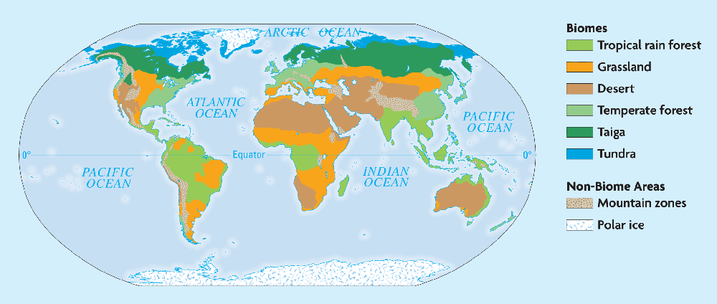
Earth is home to an incredible diversity of life.
Every part of the biosphere is connected with every other part.
The biosphere includes many environments.
land environments
The parts of the land, sea, and atmosphere in which organisms are able to live.

Slide 5
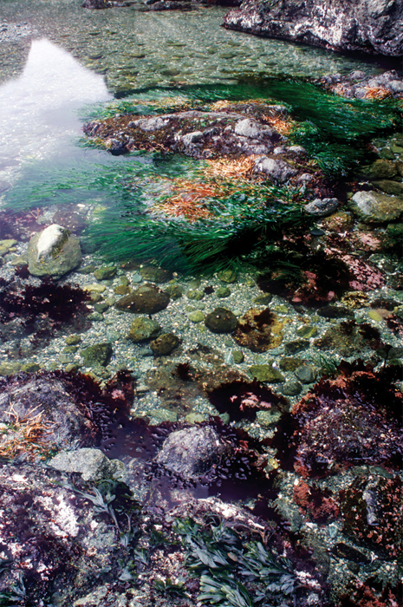
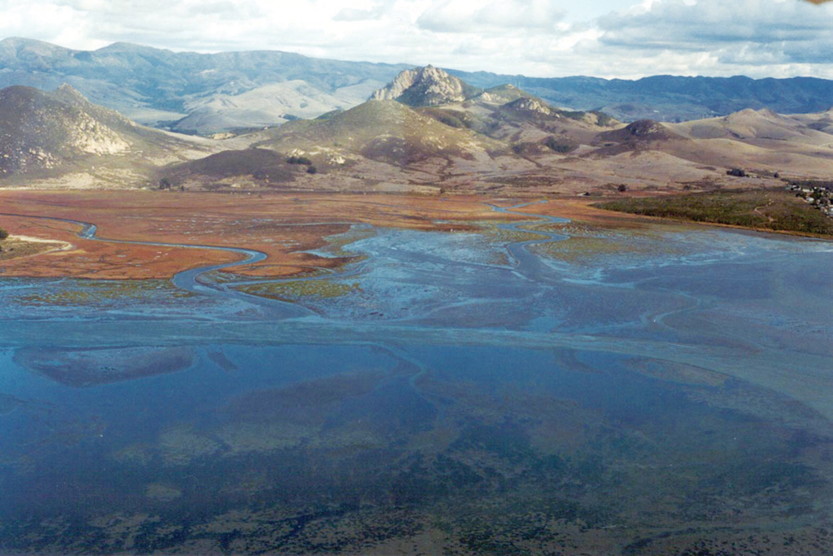
The biosphere includes many environments.
saltwater and freshwater environments
Tidepool
are rocky pools on the sea shore which are filled with seawater.
Estuary
the tidal mouth of a large river, where the tide meets the stream.
portions of the atmosphere
Notes:
Tidepool - are rocky pools on the sea shore which are filled with seawater.
Estuary - Partially enclosed coastal body of brackish water with one or more rivers or streams flowing into it, and with a free connection to the open sea. Estuaries form a transition zone between river (naturally flowing- freshwater)environments and maritime (connected to the sea) environments.
Brackish water or briny water is water that has more salinity than fresh water, but not as much as seawater. It may result from mixing of seawater with fresh water, as in estuaries, or it may occur in brackish fossil aquifers.

Slide 6
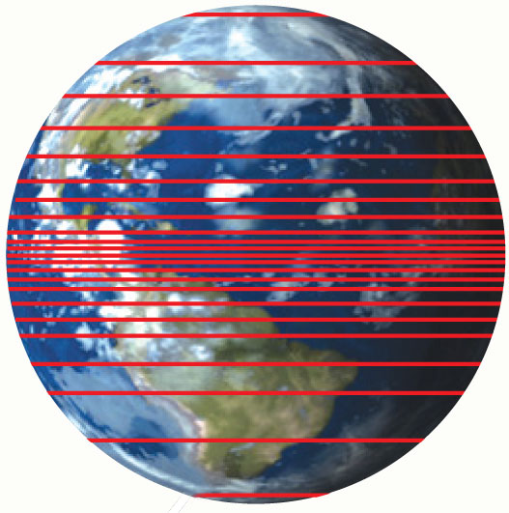
Biodiversity is the variety of life.
Biodiversity generally increases from the poles to the equator.
Biodiversity is greater in areas with consistently warm temperatures.
Biodiversity is greater closer to the equator.
Notes:
Because the climate is better suited to sustain life. Resources abundant. In the tropics you don't get high fluctuations of temperature. I used to live in Trinidad, it's pretty much a high of 30-33 degrees celsius all year round. When I lived in NY the temperature varied from 10-40 degrees celsius there. Go further north and the temperature variance is greater. Life has to adapt to freezing cold climate as they move away from the equator, only a few can do that.
Comparing biodiversity in the temperate zones with that in the tropics is like comparing the coins in your pocket with the coins in your piggy bank, he added. "There are usually more coins in your piggy bank than in your pocket. But you're always spending the coins in your pocket, and receiving new coins in the form of change. The coins in your piggy bank turn over less often, but over time they add up."

Slide 7
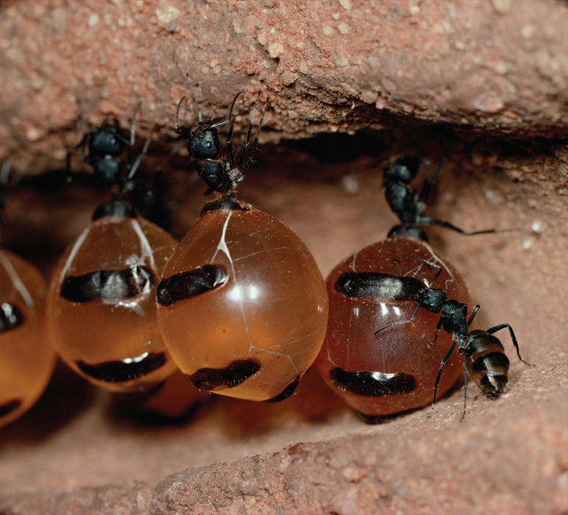
A species is one particular type of living thing.
Members of a species can interbreed to reproduce.
There are about 2 million different living species have been identified.
The abdomen of the ant contains two stomachs. One stomach holds the food for itself and second stomach is for food to be shared with other ants.
Why would these honey pot ants need this adaptation?
Notes:
to cause animals of two different species to produce young animals that are a mixture of the two species
Breed - to produce (offspring); procreate;

Slide 8
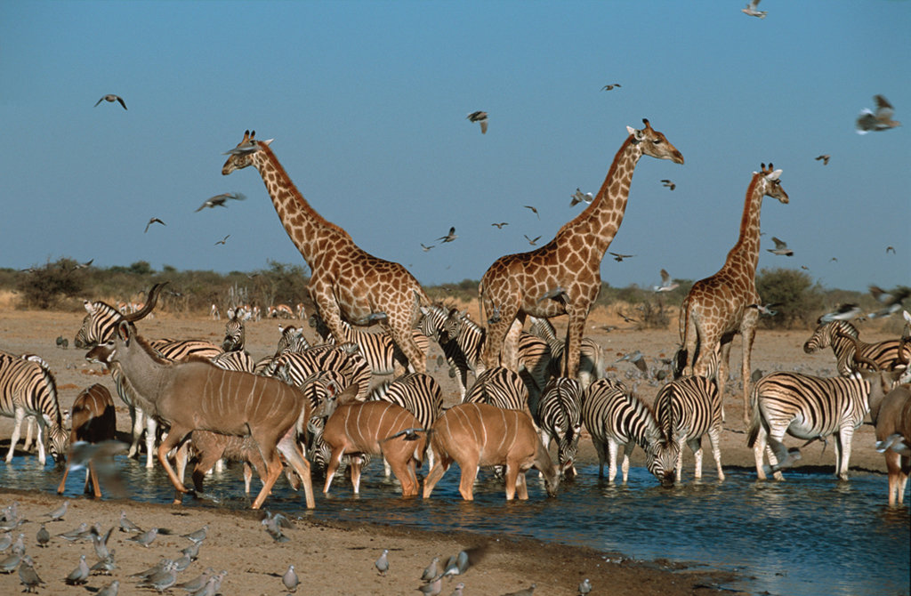
All organisms share certain characteristics.
Biology is the scientific study of all forms of life.

Slide 9
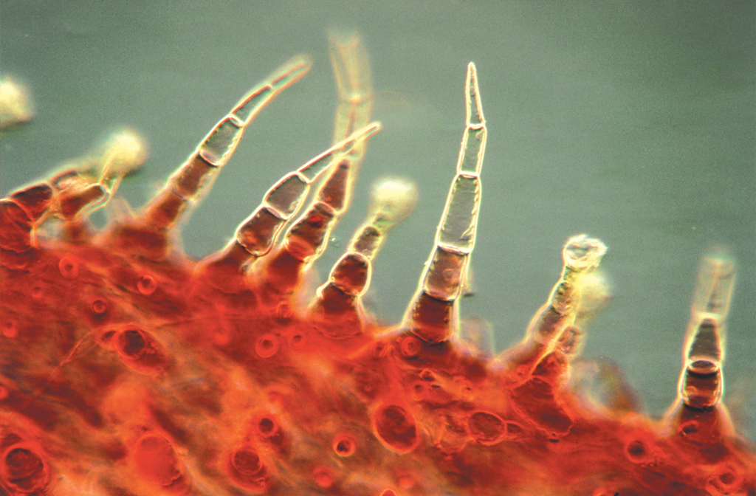
An organism is any individual living thing.
Cells can work together in specialized structures,
such as these leaf hairs that protect the leaf from insects.
Notes:
Amoebae, slime mold, algae and protactists are some examples of unicellular organisms. Unicellular organisms fall under the main groups of bacteria, archaea, protozoa, single-celled algae and single-celled fungi. The two general categories are prokaryotes, which lack membrane-bound nuclei and membrane-bound organelles, such as mitochondria; and eukaryotes, which are more complex, having membrane-bound organelles and nuclei.
Both unicellular and multicellular Eukaryotes example are: ameoba, paramecium and the euglena are unicellular and are eukaryotes.

Slide 10
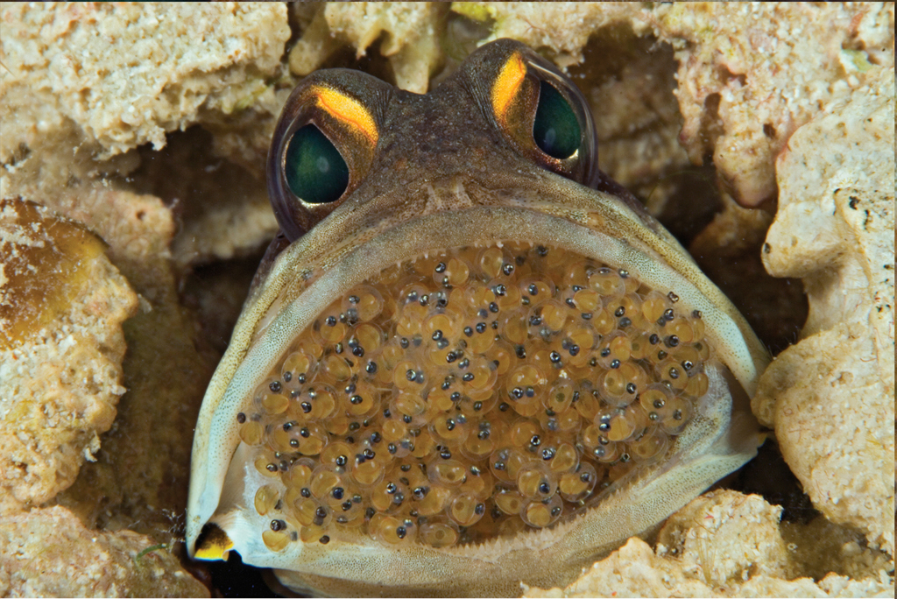
An organism is any individual living thing.
All are made of one or more cells.
All need energy for metabolism.
All respond to their environment.
All have DNA that they pass on to offspring.
A male jawfish is seen with eggs in his mouth in the Philippines. After mating, the female jawfish gives the eggs to the male. The fish are known as mouthbreeders.
Paternal mouth brooding

