Slide 1
Cardiovascular system
Mrs. Barnes

Slide 2
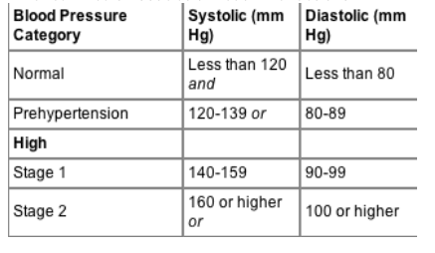
Normal Blood Pressure

Slide 3
Red blood cells
Normal range
4.2 – 5.4 million cells/mcL (microliter)
4.7 L (10 pints) : amount of blood in the body of an average adult

Slide 4
Red blood cells
Polycythemia
Poly =
Cyt =
-emia =
Many
Cell
Condition of
Causes Hypertension = high blood pressure

Slide 5
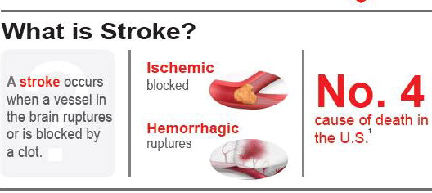
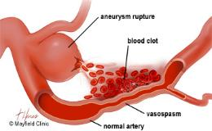
STROKE
CAUSES OF A STROKE
High blood pressure
Aneurysm (bulging vessel)
Blood disorders
(hemophilia and sickle cell anemia)

Slide 6
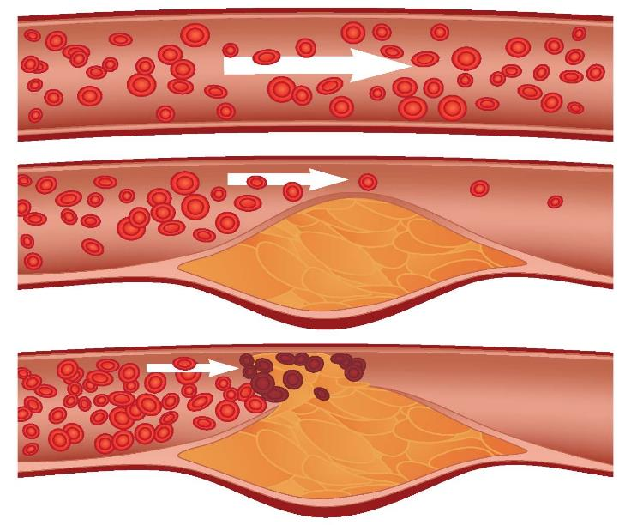
Atherosclerosis
Pressure builds and clots form.
Lack of blood flow.

Slide 7
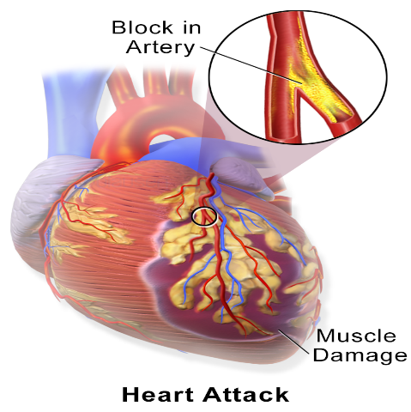
Myocardial Infarction: Heart attacks can be caused by atherosclerosis
Cholesterol

Slide 8
Causes of Hypotension = Low blood pressure

Slide 9
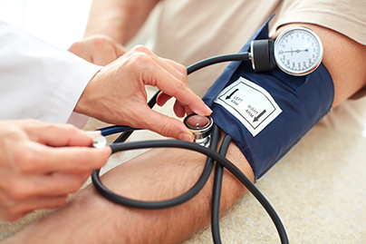
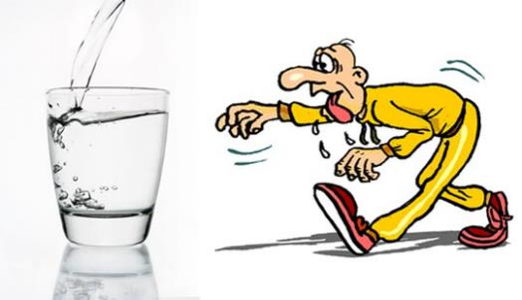
BP Below 90/60
Dehydration

Slide 10
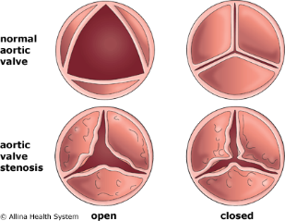
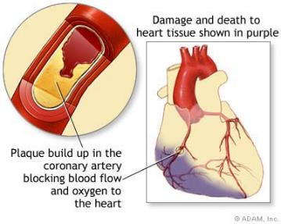
Heart valve problems
Heart attack

Slide 11
Injury

Slide 12
Why would exercise lower blood pressure?

