Slide 1
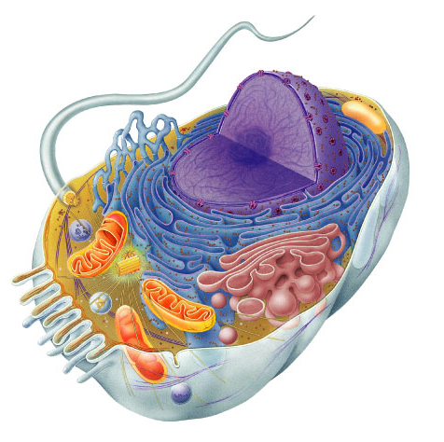
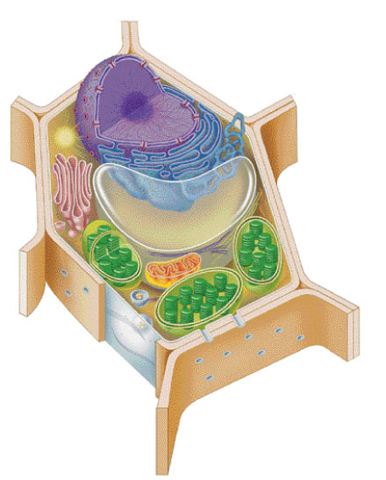
Cells & Cell Organelles
Doing Life’s Work

Slide 3
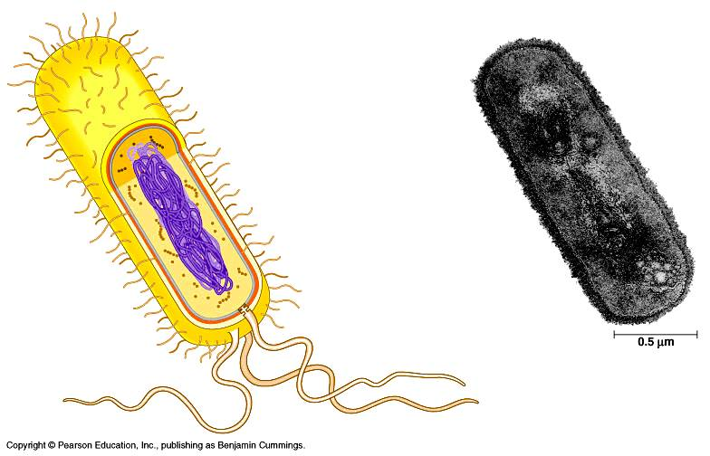
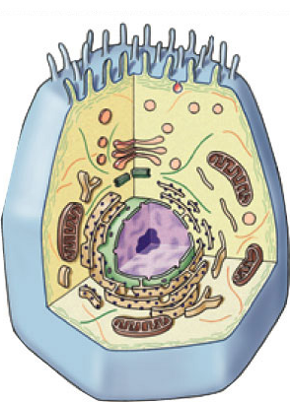
Types of cells
bacteria
cells
Prokaryote
- no organelles
Eukaryotes
- organelles
animal cells
plant cells

Slide 4
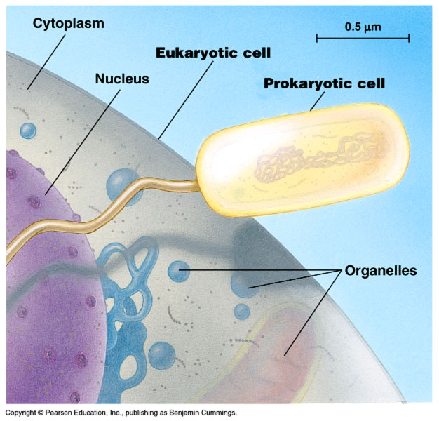
Cell size comparison
Animal cell
most bacteria
  1-10 microns
eukaryotic cells
  10-100 microns
Bacterial cell
micron = micrometer = 1/1,000,000 meter
diameter of human hair = ~20 microns

Slide 5
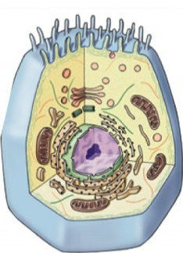
Why study cells?
Cells → Tissues → Organs → Bodies
  bodies are made up of cells
  cells do all the work of life!

Slide 6
The Work of Life
What jobs do cells have to do for an organism to live…
  “breathe”
    gas exchange: O₂ in vs. CO₂ out
  eat
    take in & digest food
  make energy
    ATP
  build molecules
    proteins, carbohydrates, fats, nucleic acids
  remove wastes
  control internal conditions
    homeostasis
  respond to external environment
  build more cells
    growth, repair, reproduction & development
ATP

Slide 7
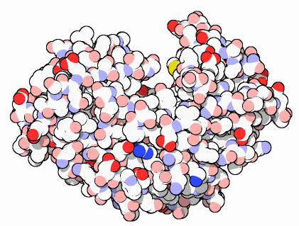
The Jobs of Cells
Cells have 3 main jobs
  make energy
    need energy for all activities
    need to clean up waste produced
    while making energy
  make proteins
    proteins do all the work in a cell,
    so we need lots of them
  make more cells
    for growth
    to replace damaged or diseased cells
ATP
Our organelles
do all these
jobs!

Slide 8
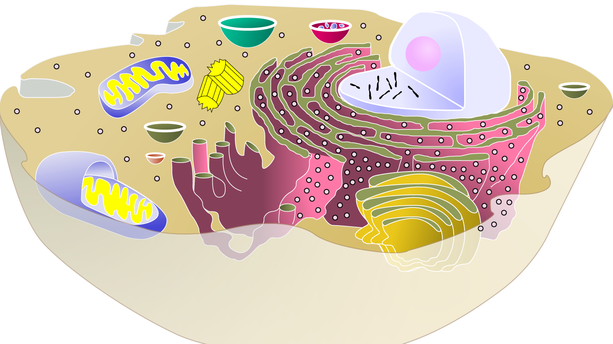
Organelles
Organelles do the work of cells
  each structure has a job to do
    keeps the cell alive; keeps you alive
They’re like
mini-organs!
Model Animal Cell

Slide 9


1. Cells need power!
Making energy
  to fuel daily life & growth, the cell must…
    take in food & digest it
    take in oxygen (O₂)
    make ATP
    remove waste
  organelles that do this work…
    cell membrane
    lysosomes
    vacuoles & vesicles
    mitochondria
ATP

Slide 10
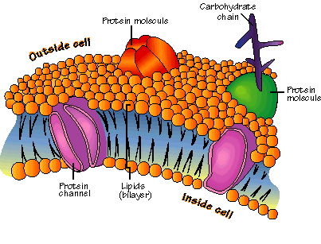
Cell membrane
phosphate
“head”
Function
  separates cell from outside
  controls what enters or leaves cell
    O₂, CO₂, food, H₂O, nutrients, waste
  recognizes signals from other cells
    allows communication between cells
Structure
  double layer of fat
    phospholipid bilayer
  receptor molecules
    proteins that
    receive signals
lipid “tail”

Slide 11
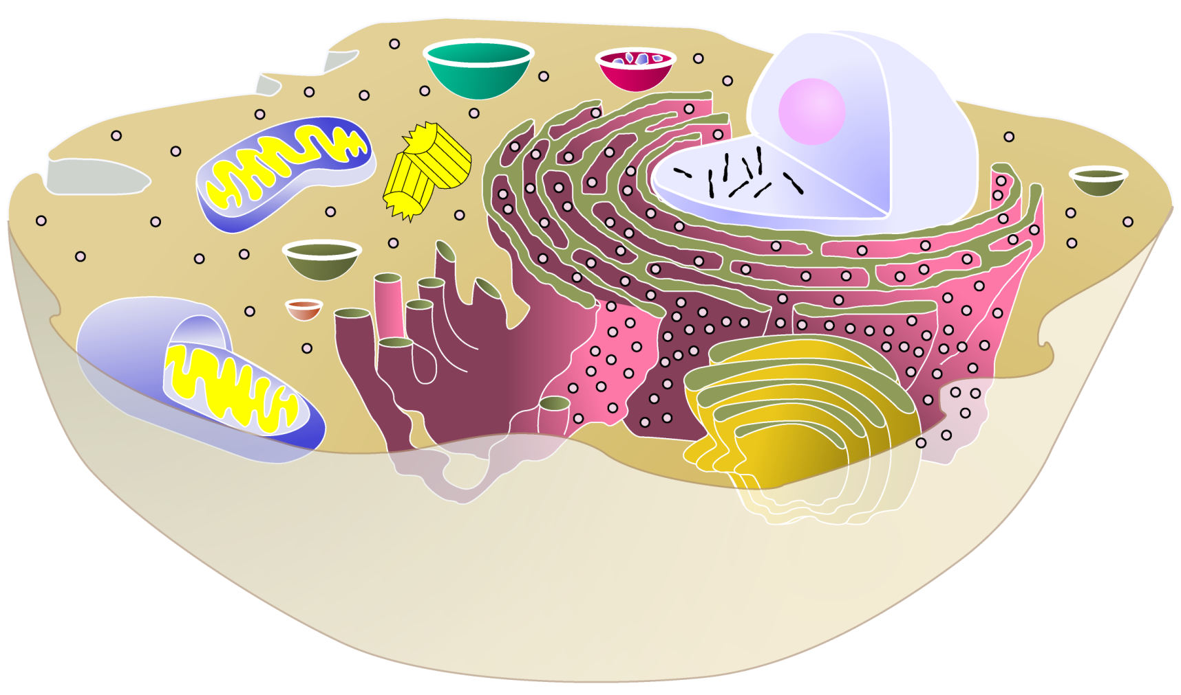
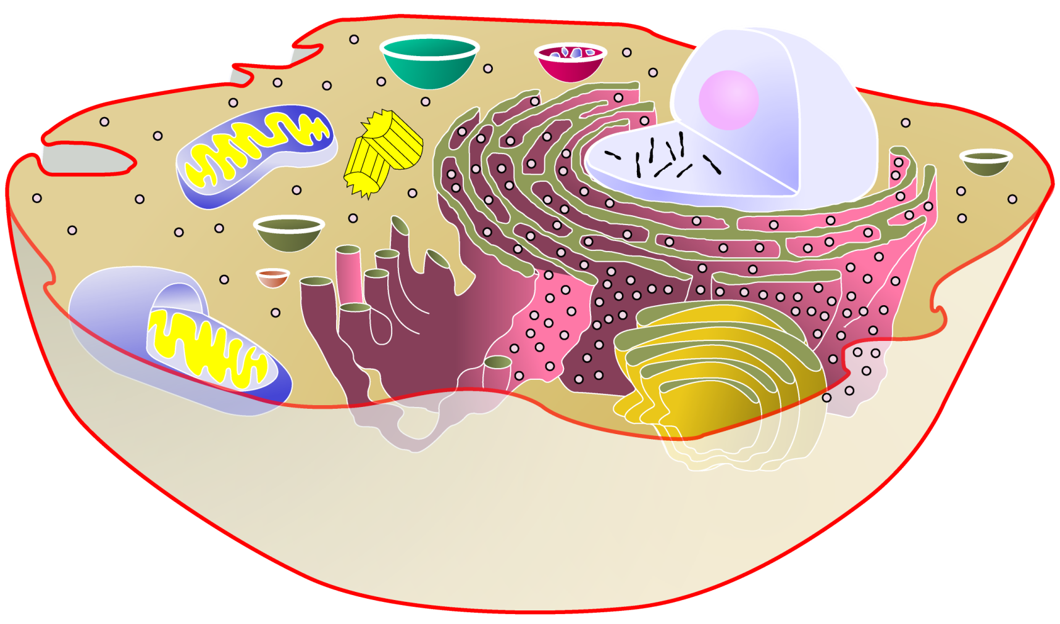
cytoplasm
▪jelly-like material holding
organelles in place
cell membrane
▪cell boundary
▪controls movement
of materials in & out
▪recognizes signals

Slide 12
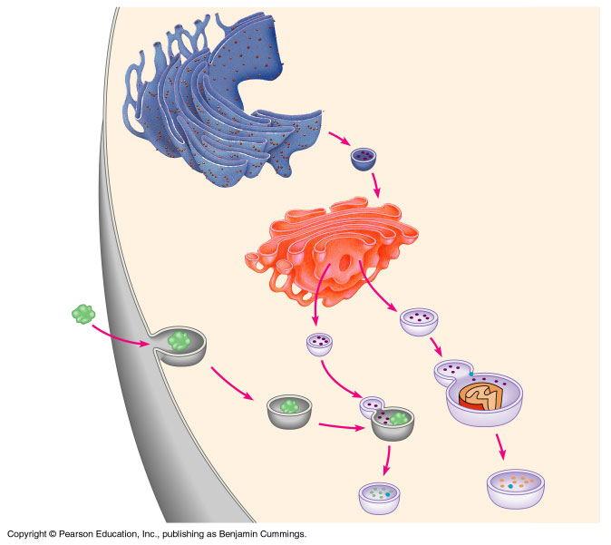
Vacuoles & vesicles
Function
  moving material around cell
  storage
Structure
  membrane sac
small food
particle
vacuole filled w/
digestive enzymes
vesicle
vesicle filled w/
digested nutrients

Slide 13
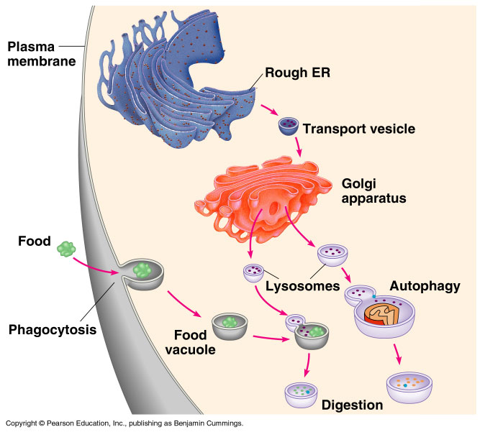
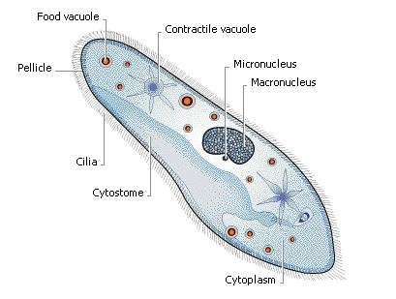
Food & water storage
food vacuole
plant cells
central vacuole
animal cells
contractile
vacuole

Slide 14
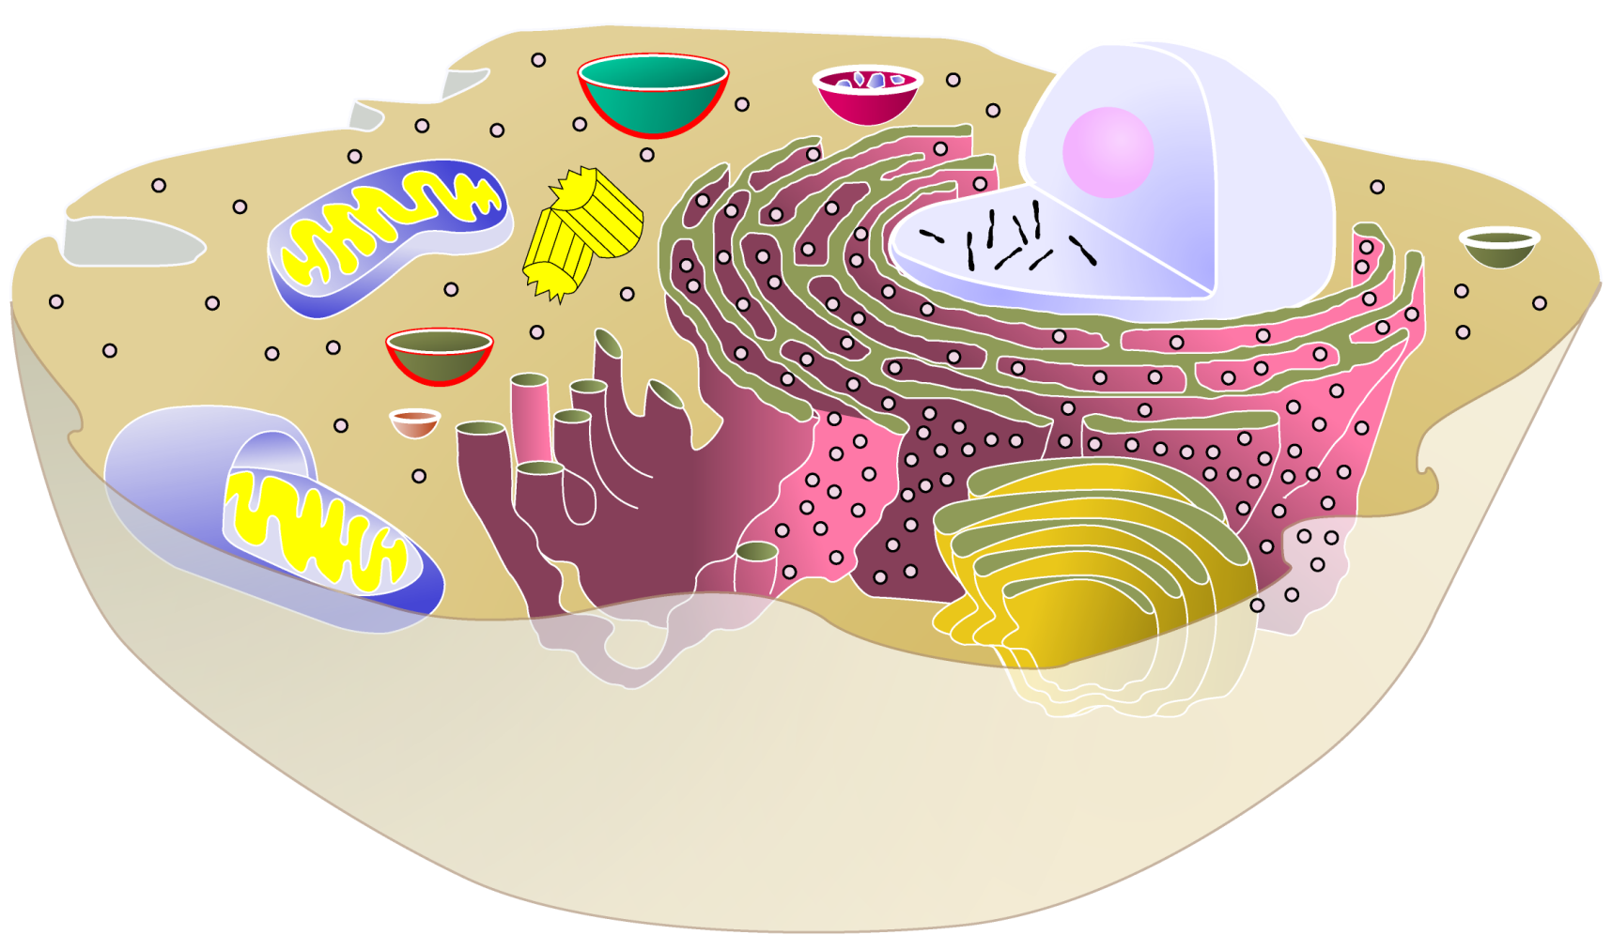
cytoplasm
▪jelly-like material holding
organelles in place
vacuole & vesicles
▪transport inside cells
▪storage
cell membrane
▪cell boundary
▪controls movement
of materials in & out
▪recognizes signals

Slide 15
Lysosomes
Function
  digest food
    used to make energy
  clean up & recycle
    digest broken organelles
Structure
  membrane sac of digestive enzymes
lysosomes
digesting broken
organelles
small food
particle
vacuole
digesting food

Slide 16
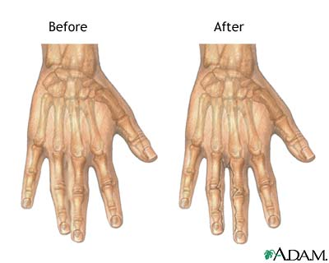
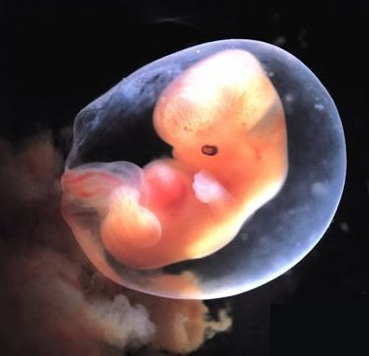
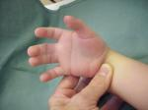
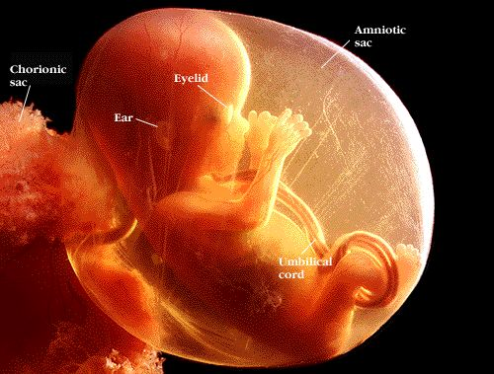
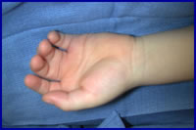
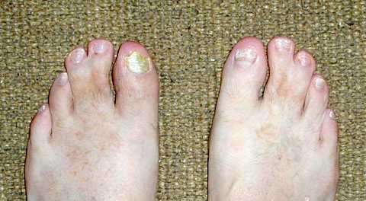
A Job for Lysosomes
6 weeks
15 weeks

Slide 17

cytoplasm
▪jelly-like material holding
organelles in place
lysosome
▪food digestion
▪garbage disposal &
recycling
vacuole & vesicles
▪transport inside cells
▪storage
cell membrane
▪cell boundary
▪controls movement
of materials in & out
▪recognizes signals

Slide 18
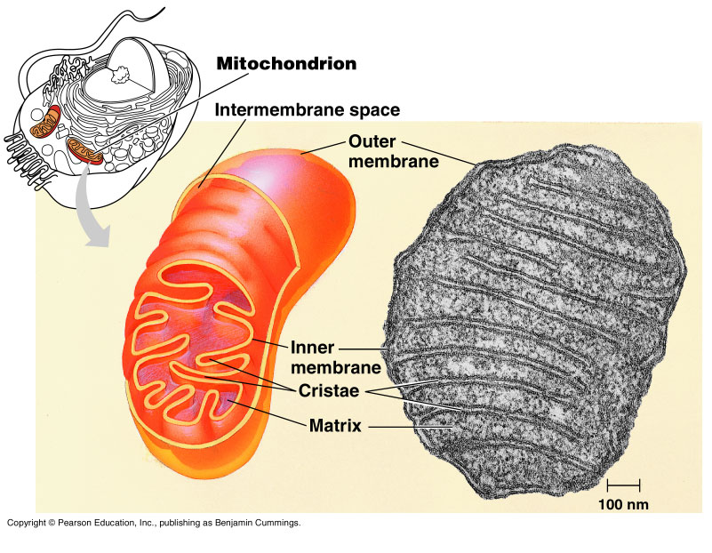
Mitochondria
Function
  make ATP energy from cellular respiration
    sugar + O₂ → ATP
    fuels the work of life
Structure
  double membrane
ATP
in both animal & plant cells

Slide 19

cytoplasm
▪jelly-like material holding
organelles in place
lysosome
▪food digestion
▪garbage disposal &
recycling
vacuole & vesicles
▪transport inside cells
▪storage
mitochondria
▪make ATP energy
from sugar + O₂
cell membrane
▪cell boundary
▪controls movement
of materials in & out
▪recognizes signals

