Slide 1
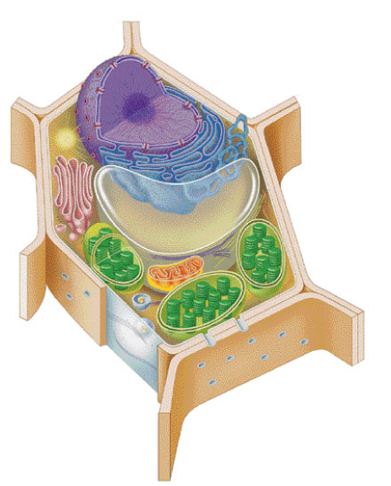
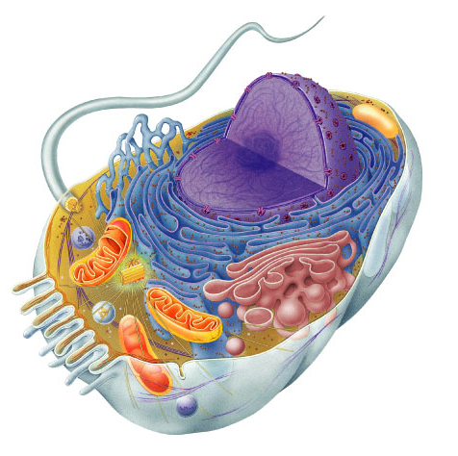
Mitochondria are in both cells!!
animal cells
plant cells
mitochondria
chloroplast

Slide 2
cytoplasm
▪jelly-like material
around organelles
central vacuole
▪storage: food,
water or waste
mitochondria
▪make ATP in
cellular respiration
cell wall
▪support
cell membrane
▪cell boundary
▪controls movement
of materials in & out
▪recognizes signals
chloroplast
▪make ATP & sugars in
photosynthesis
lysosome
▪digestion & clean up

Slide 3
2. Cells need workers = proteins!
Making proteins
  to run daily life & growth, the cell must…
    read genes (DNA)
    build proteins
      structural proteins (muscle fibers, hair, skin, claws)
      enzymes (speed up chemical reactions)
      signals (hormones) & receptors
  organelles that do this work…
    nucleus
    ribosomes
    endoplasmic reticulum (ER)
    Golgi apparatus

Slide 4
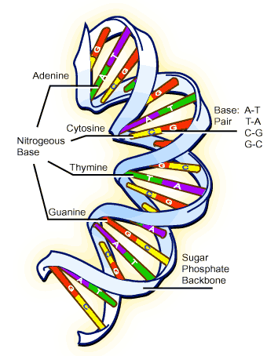
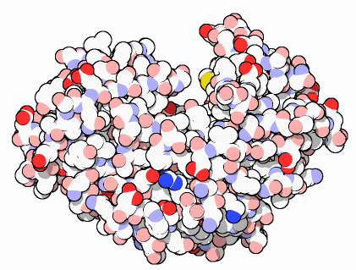
Proteins do all the work!
one of the major job of cells is to make proteins,
because…
proteins do all the work!
structural
enzymes
signals
receptors
DNA
proteins
cells

Slide 5
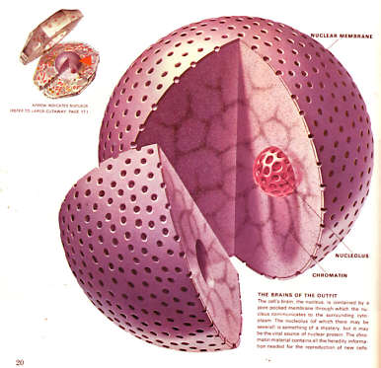
Nucleus
Function
  control center of cell
  protects DNA
    instructions for building proteins
Structure
  nuclear membrane
  nucleolus
    ribosome factory
  chromosomes
    DNA

Slide 6
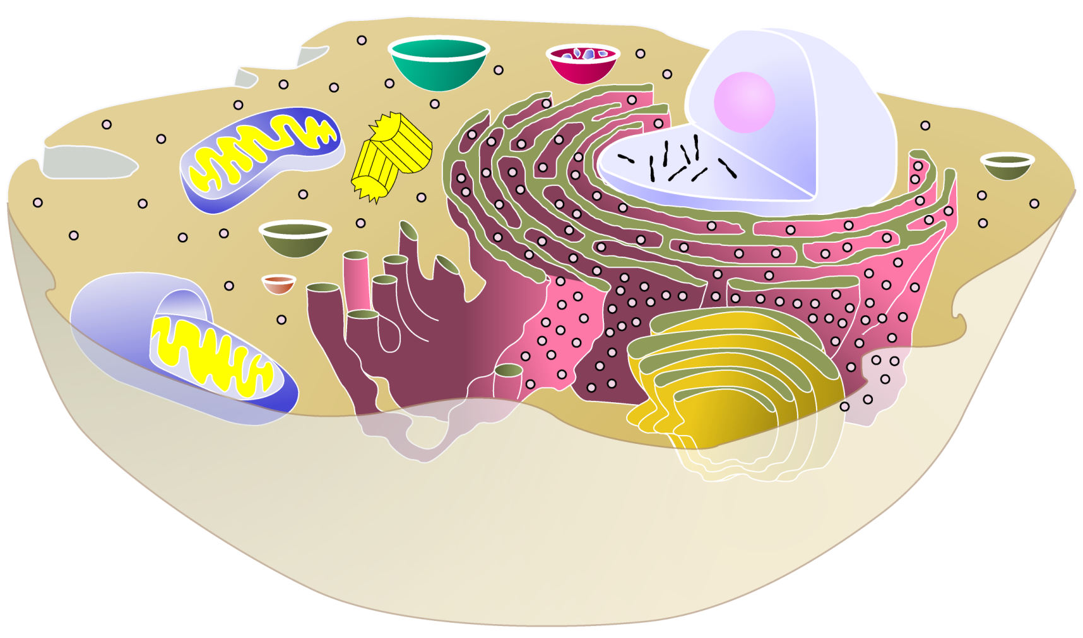
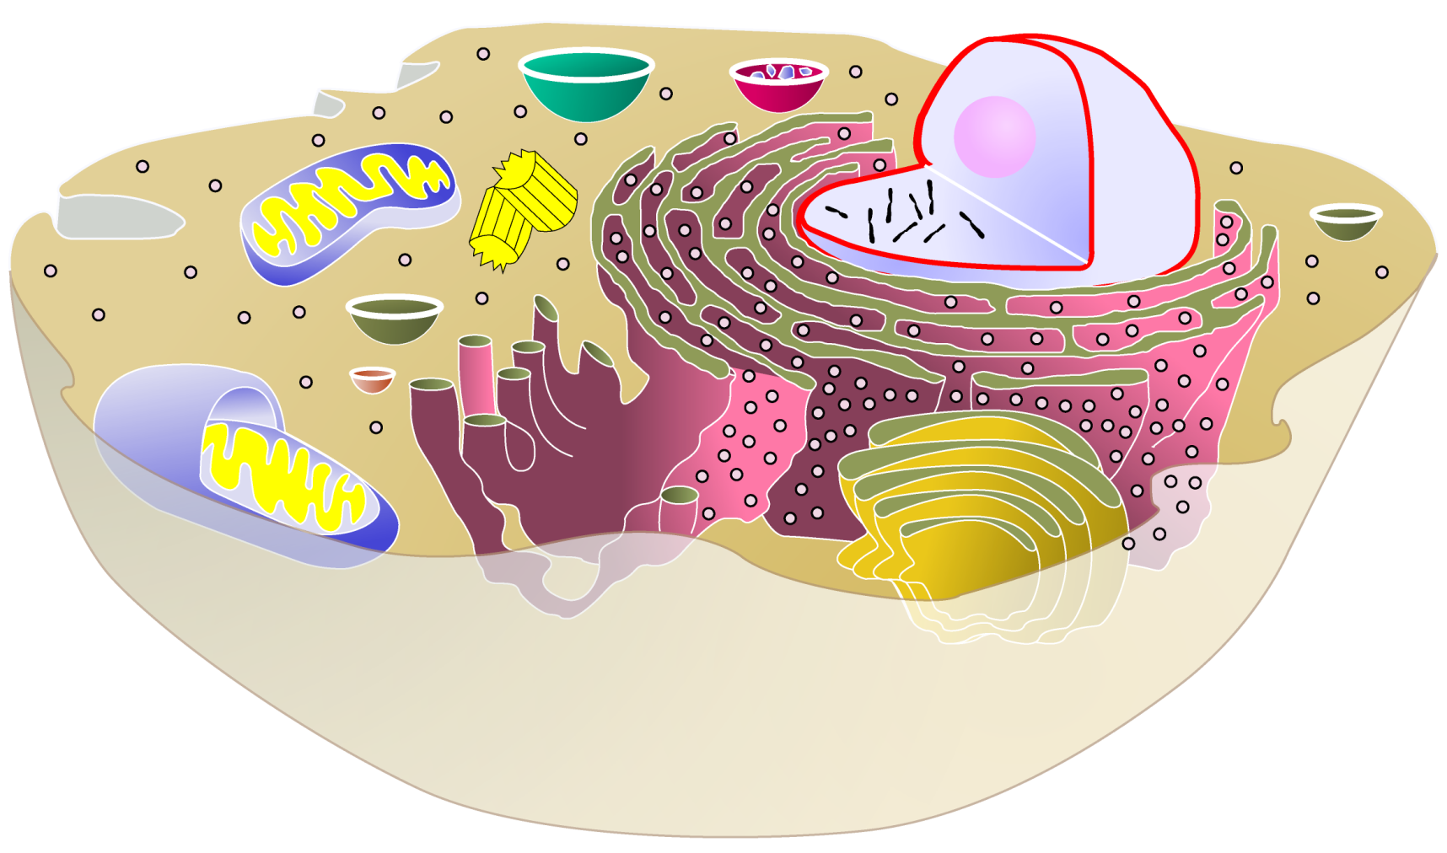
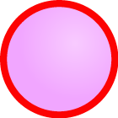
cytoplasm
▪jelly-like material holding
organelles in place
lysosome
▪food digestion
▪garbage disposal &
recycling
nucleolus
▪produces
ribosomes
vacuole & vesicles
▪transport inside cells
▪storage
nucleus
▪protects DNA
▪controls cell
chromosomes
▪DNA
mitochondria
▪make ATP energy
from sugar + O₂
cell membrane
▪cell boundary
▪controls movement
of materials in & out
▪recognizes signals

Slide 7
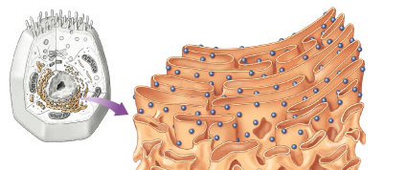
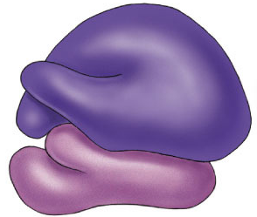
Ribosomes
Function
  protein factories
  read instructions to build proteins from DNA
Structure
  some free in cytoplasm
  some attached to ER
Ribosomes on ER

Slide 8
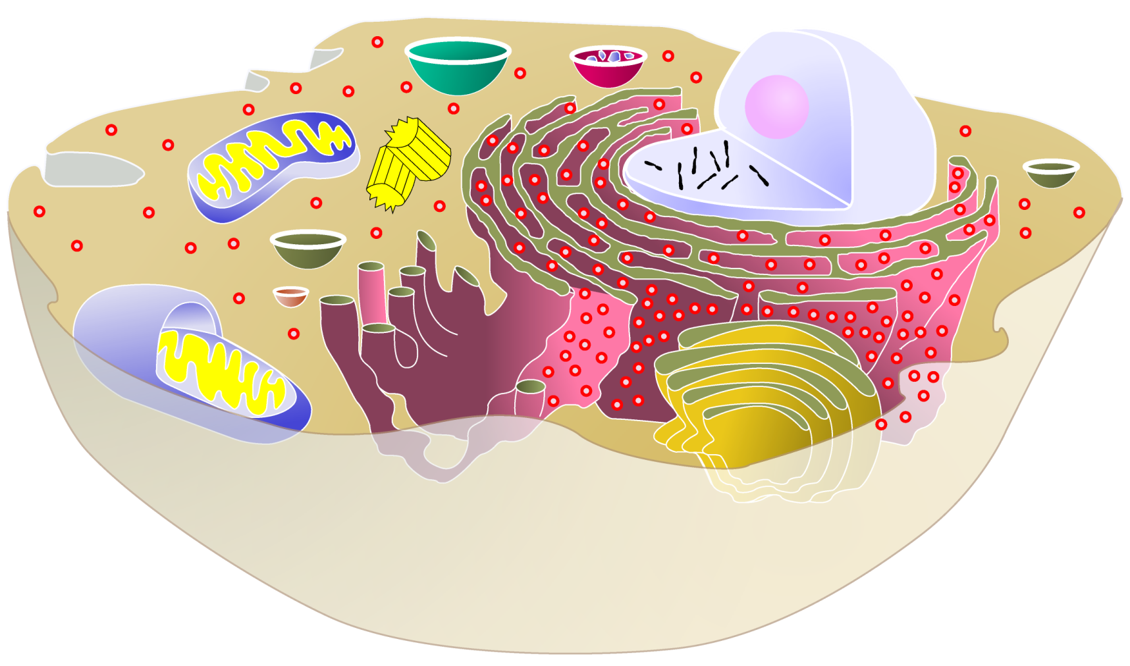
cytoplasm
▪jelly-like material holding
organelles in place
lysosome
▪food digestion
▪garbage disposal &
recycling
nucleolus
▪produces
ribosomes
vacuole & vesicles
▪transport inside cells
▪storage
nucleus
▪protects DNA
▪controls cell
ribosomes
▪build proteins
mitochondria
▪make ATP energy
from sugar + O₂
cell membrane
▪cell boundary
▪controls movement
of materials in & out
▪recognizes signals

Slide 9
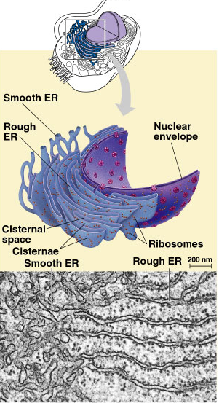
Endoplasmic Reticulum
Function
  works on proteins
    helps complete the
    proteins after ribosome builds them
  makes membranes
Structure
  rough ER
    ribosomes attached
    works on proteins
  smooth ER
    makes membranes

Slide 10

cytoplasm
▪jelly-like material holding
organelles in place
lysosome
▪food digestion
▪garbage disposal &
recycling
vacuole & vesicles
▪transport inside cells
▪storage
nucleus
▪protects DNA
▪controls cell
ribosomes
▪builds proteins
mitochondria
▪make ATP energy
from sugar + O₂
cell membrane
▪cell boundary
▪controls movement
of materials in & out
▪recognizes signals
ER
▪works on proteins
▪makes membranes

Slide 11
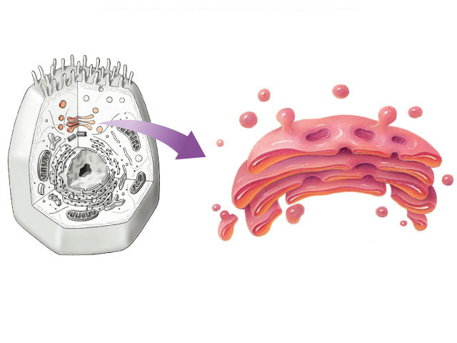
Golgi Apparatus
Function
  finishes, sorts, labels & ships proteins
    like UPS headquarters
      shipping & receiving department
  ships proteins in vesicles
    “UPS trucks”
Structure
  membrane sacs
vesicles
carrying proteins
transport vesicles

Slide 12
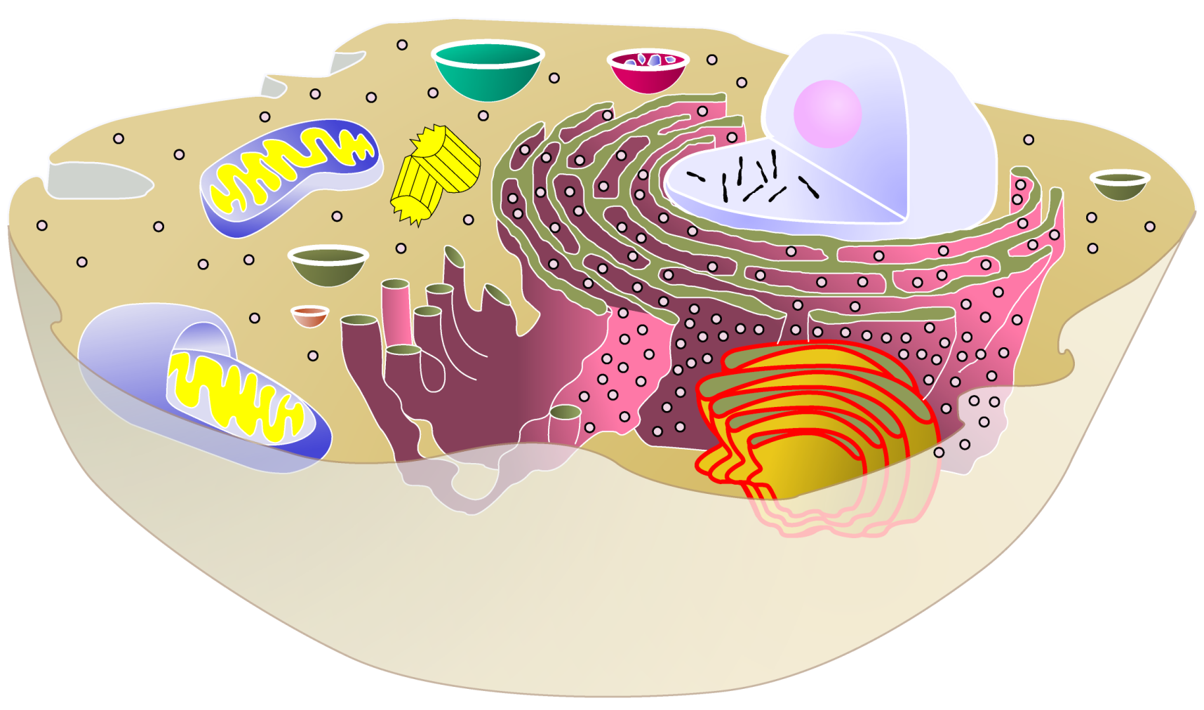
cytoplasm
▪jelly-like material holding
organelles in place
lysosome
▪food digestion
▪garbage disposal &
recycling
vacuole & vesicles
▪transport inside cells
▪storage
nucleus
▪protects DNA
▪controls cell
ribosomes
▪builds proteins
mitochondria
▪make ATP energy
from sugar + O₂
Golgi apparatus
▪finishes, packages
& ships proteins
cell membrane
▪cell boundary
▪controls movement
of materials in & out
▪recognizes signals
ER
▪helps finish proteins
▪makes membranes

Slide 13
endoplasmic
reticulum
nucleus
DNA
protein
on its way!
TO:
RNA
vesicle
TO:
TO:
vesicle
ribosomes
TO:
protein
finished
protein
Golgi
apparatus
Making Proteins

Slide 14
nucleolus
▪make ribosomes
endoplasmic reticulum
▪processes proteins
▪makes membranes
nucleus
▪control cell
▪protects DNA
ribosomes
▪make proteins
cytoplasm
▪jelly-like material
around organelles
central vacuole
▪storage: food,
water or waste
Golgi apparatus
▪finish & ship
proteins
mitochondria
▪make ATP in
cellular respiration
cell wall
▪support
cell membrane
▪cell boundary
▪controls movement
of materials in & out
▪recognizes signals
chloroplast
▪make ATP & sugars in
photosynthesis
lysosome
▪digestion & clean up

Slide 15
3. Cells need to make more cells!
Making more cells
  to replace, repair & grow,
  the cell must…
    copy their DNA
    make extra organelles
    divide the new DNA & new organelles between 2 new “daughter” cells
  organelles that do this work…
    nucleus
    centrioles

Slide 16
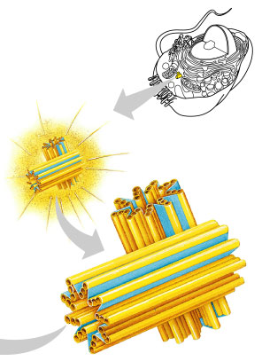
Centrioles
Function
  help coordinate cell division
    only in animal cells
Structure
  one pair in each cell

Slide 17
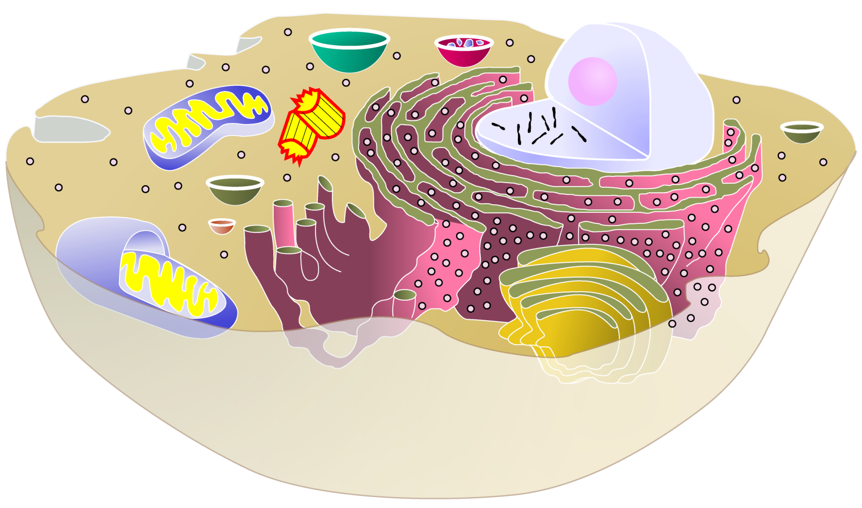
cytoplasm
▪jelly-like material holding
organelles in place
lysosome
▪food digestion
▪garbage disposal &
recycling
vacuole & vesicles
▪transport inside cells
▪storage
nucleus
▪protects DNA
▪controls cell
centrioles
▪cell division
ribosomes
▪builds proteins
mitochondria
▪make ATP energy
from sugar + O₂
Golgi apparatus
▪finishes, packages
& ships proteins
cell membrane
▪cell boundary
▪controls movement
of materials in & out
▪recognizes signals
ER
▪helps finish proteins
▪makes membranes

Slide 18
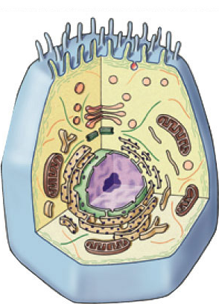
Cell Summary
Cells have 3 main jobs
  make energy
    need food + O₂
    cellular respiration & photosynthesis
    need to remove wastes
  make proteins
    need instructions from DNA
    need to chain together amino acids & “finish”
    & “ship” the protein
  make more cells
    need to copy DNA & divide it up to daughter cells
Our organelles
do all those
jobs!

Slide 19
That’s my
cellular story…
Any Questions?

