Slide 1
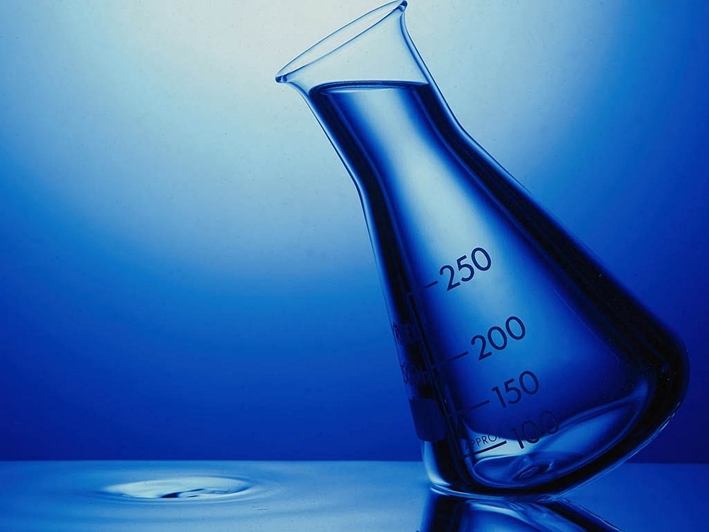
Chapter 2-1: The Nature of Matter

Slide 2
Daily Objectives
Identify the three subatomic particles found in atoms
Explain how compounds are different from the elements they are made up of.
Describe the two main types of chemical bonds.

Slide 3
Atoms
The study of chemistry begins with the basic unit of matter, the atom.
The concept of the atom has been around for nearly 2500 years.
Atom comes from the Greek word atomos, which means “unable to be cut.”

Slide 4
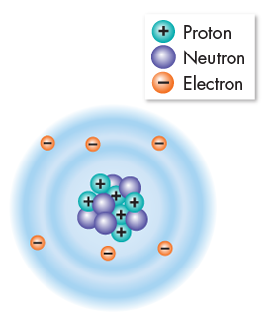
Atoms
Atoms are incredibly small. Placed side by side, 100 million atoms would make a row only about 1 cm long.
The three subatomic particles that make up atoms are protons, neutrons, and electrons.

Slide 5
Protons and Neutrons
Protons and neutrons have about the same mass. (1 amu)
Protons are positively charged particles (+) and neutrons carry no charge at all.
Strong forces bind protons and neutrons together to form the nucleus, at the center of the atom.

Slide 6
Electrons
The electron is a negatively charged particle (–) with only 1/1840 the mass of a proton.
Electrons are in constant motion in the space surrounding the nucleus.

Slide 7
Electrons
Because atoms have equal numbers of electrons and protons, their positive and negative charges balance out, and atoms are electrically neutral.

Slide 8
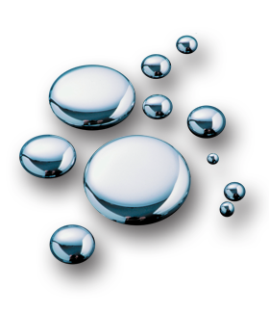
Elements and Isotopes
A chemical element is a pure substance that consists entirely of one type of atom.
Elements are represented by one or two letter symbols.
Example: C for carbon, H for hydrogen, Na for sodium

Slide 9
Elements and Isotopes
The number of protons in the nucleus of an element is called its atomic number.
Carbon’s atomic number is 6, meaning that each atom of carbon has six protons and, consequently, six electrons. (Not in notes)

Slide 10
Isotopes
Atoms of an element may have different numbers of neutrons.
Atoms of the same element that differ in the number of neutrons they contain are known as isotopes.

Slide 11
Isotopes
The total number of protons + neutrons in the nucleus of an atom is called its mass number.
Isotopes are identified by their mass numbers.
Ex. Carbon-12, Carbon-13, and Carbon-14.

Slide 12
Isotopes
Since they have the same number of electrons, all isotopes of an element have the same chemical properties.

Slide 13
Radioactive Isotopes
Some isotopes are radioactive, meaning that their nuclei are unstable and break down at a constant rate over time.
Uses:
- Determine the ages of rocks and fossils
- Detect and treat cancer
- Kill bacteria that causes food to spoil.
- Labels or “tracers” to follow the movements of substances

Slide 14
Chemical Compounds
A chemical compound is a substance formed by the chemical combination of two or more elements in definite proportions.
Scientists show the composition of compounds by a kind of shorthand known as a chemical formula.
Water: H₂O
Table salt: NaCl

Slide 15
Chemical Compounds
The physical and chemical properties of a compound are usually very different from those of the elements from which it is formed.
For example, sodium reacts explosively with cold water. Chlorine is a very reactive, poisonous, greenish gas that was used in battles during World War I.
However, the compound sodium chloride--table salt--is a white solid that dissolves easily in water, is not poisonous, and is essential for the survival of most living things.

Slide 16
Chemical Bonds
Atoms in compounds are held together by various types of chemical bonds.
Bond formation involves the electrons that surround each atomic nucleus.
The electrons that are available to form bonds are called valence electrons.
The main types of chemical bonds are ionic bonds and covalent bonds.

Slide 17
Ionic Bonds
An ionic bond is formed when one or more electrons are transferred from one atom to another.
An atom that loses electrons becomes positively charged. An atom that gains electrons has a negative charge. These positively and negatively charged atoms are known as ions.

Slide 18
Ionic Bonds
Since the ions are oppositely charged they are strongly attracted to each other, forming an ionic bond.

Slide 19
Ionic Bonds
Ionic bonds form between sodium and chlorine to form NaCl, table salt.

Slide 20
Ionic Bonds
A sodium atom easily loses its one valence electron and becomes a sodium ion (Na+).

Slide 21
Ionic Bonds
A chlorine atom easily gains an electron (from sodium) and becomes a chloride ion (Cl-).

Slide 22
Covalent Bonds
Sometimes electrons are shared by atoms instead of being transferred.
The moving electrons travel about the nuclei of both atoms, forming a covalent bond.
Share 2 electrons = Single covalent bond
Share 4 electrons = Double covalent bond
Share 6 electrons = Triple covalent bond.

Slide 23
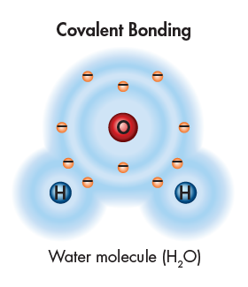
Covalent Bonds
The structure that results when atoms are joined together by covalent bonds is called a molecule, the smallest unit of most compounds.
This diagram of a water molecule shows that each hydrogen atom is joined to water’s lone oxygen atom by a single covalent bond.
Each hydrogen atom shares two electrons with the oxygen atom.

Slide 24
Van der Waals Forces
Atoms of different elements do not all have the same ability to attract electrons.
Some atoms have a stronger attraction for electrons than do other atoms.
When molecules are close together, a slight attraction can develop between the oppositely charged regions of nearby molecules.

Slide 25
Van der Waals Forces
When molecules are close together, a slight attraction can develop between the oppositely charged regions of nearby molecules.

