Slide 1
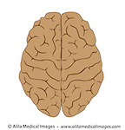
Which part?

Slide 2
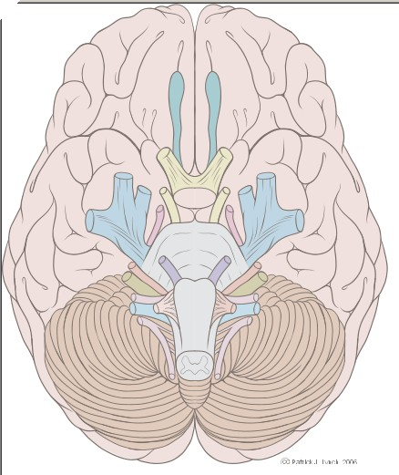
Which part?

Slide 3
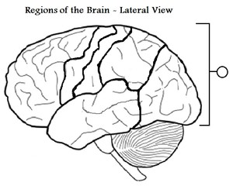
Which part?

Slide 4
Which part?

Slide 5
Which part?

Slide 6
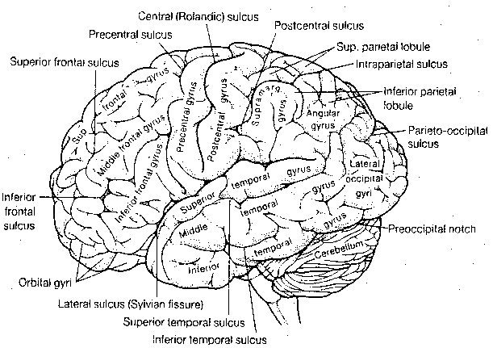
There are many more?

Slide 7
Disease and Immunity
Biology I Honors

Slide 8
What are the categories of organisms that cause disease?
Bacteria
Viruses
Fungi
Protozoa
Parasites

Slide 9
How do each cause disease??
Bacteria
release chemicals
Viruses
Take over a cell and use it to make more virus
Fungi
Take the cells’ nutrition and occur in warm
moist places.
Protozoa
Use healthy cells to complete their life cycle.
Parasites
Grow and feed in a host.

Slide 10
What is an organism that causes disease called?
Bacteria
Viruses
A Pathogen
Fungi
Protozoa
Parasites

Slide 11
Examples of Pathogens
Notes:
Which need a Vector?

Slide 12
How do scientist confirm that an organism actually caused a disease?
Koch’s Postulates
Pathogen must be isolated in every case
Then the isolated organisms must be grown in pure culture.
Healthy animals infected with organism contract same disease.
The pathogen is then re-isolated in culture and is identical to the initial organism

Slide 13
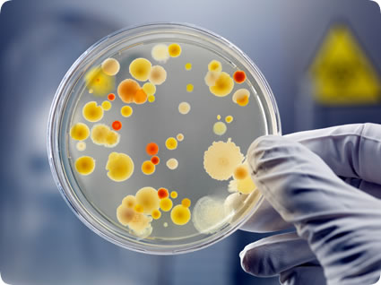
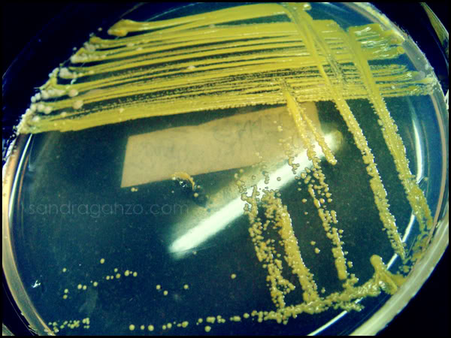
Pure vs non-pure culture

Slide 14
Immunity: The Cells

Slide 15
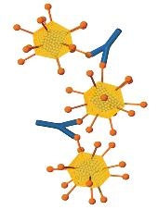
The Proteins:
Antibodies make pathogens ineffective.
antibody
pathogens
Interferon prevents viruses from infecting healthy cells

Slide 16
Types of Immunity
Passive
Genetic: immediate but short lived
Mother to child: breast milk, umbilical cord
Active
Pathogen specific response
Acquired Immunity is an effect. Vaccines

Slide 17
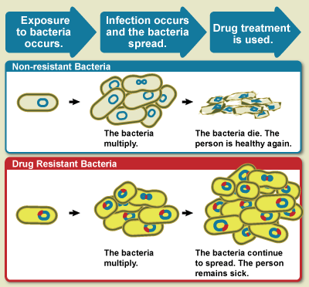
Antibiotics vs. Vaccines
Antibiotics and Antiseptic: Cause bacteria to burst.

Slide 18
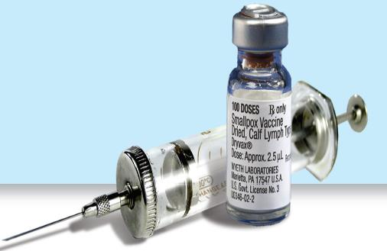
Antibiotics vs. Vaccines
Vaccines: Acquired immunity against viruses.
.
Given to prevent illness.
Contain the antigen of a weakened pathogen.
http://mit.tv/ID72AB

Slide 20
Immune Responses
Non-Specific
Specific

Slide 21
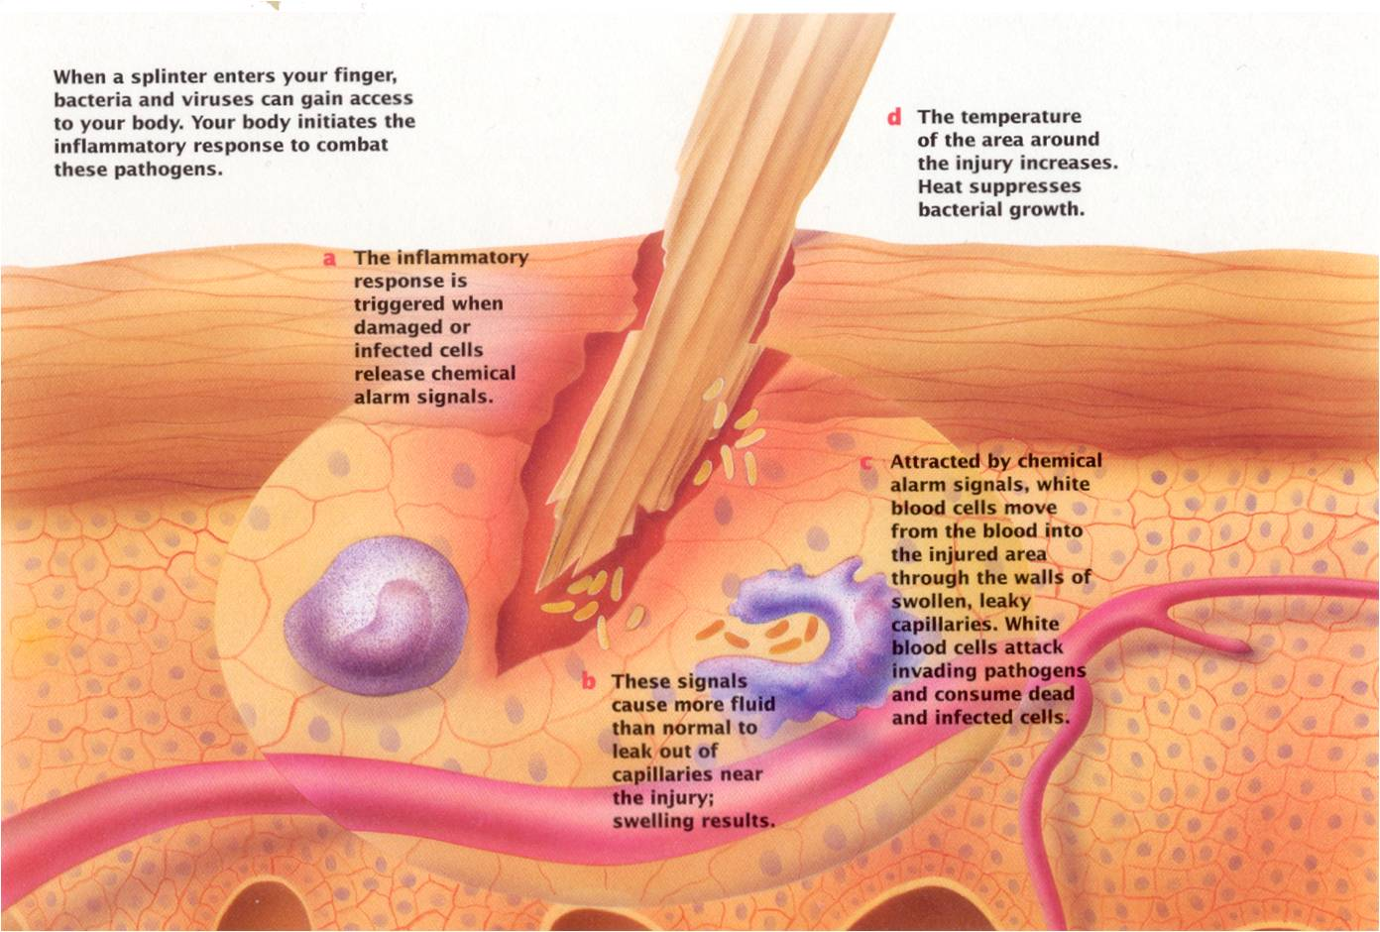
Non-Specific Immune responses
Happen the same way no matter which pathogen you have.

Slide 22
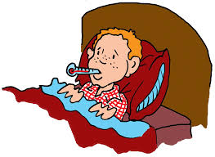
Inflammation and Fever
Mast cells, found in the tissues, release chemicals, which cause the
Hypothalamus, in the brain to increase the body’s temperature.
Low fevers increase the production of mature of WBCs.

Slide 23
Specific Immune Responses
Lead to immunity
Occur on cellular level
Pathogens are identified by their Antigens.
2 Types of Specific Immune Responses
Cellular Immune Response
Humoral Immune Response

Slide 24
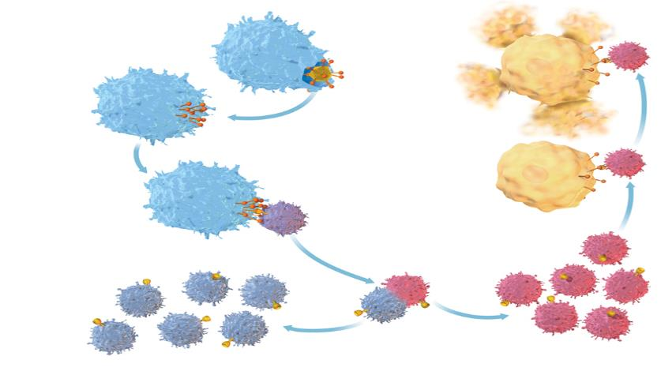
Specific Immune Responses
Cellular Immune Response
Binds and bursts
pathogen
Phagocyte engulfs pathogen
antigens
antigens
T cell
T-Cell binds to receptors and is activated
receptors
activated T cells
memory T cells
T-Cell divides

Slide 25
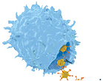
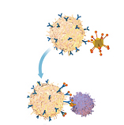
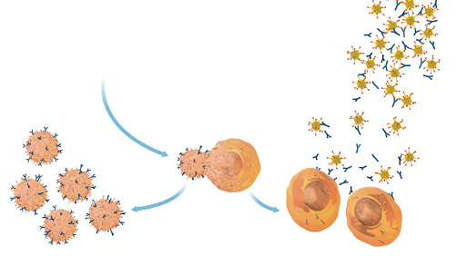
Specific Immune Responses
Humoral Immune Response
Pathogen binds to antibody
Located on surface of a B-cell
Phagocytes EAT Yum
Yum!!
B cell
pathogen
antibodies
T-cell then attaches
To the antibody and
B-cell is stimulated.
T cell
Produce antibodies
memory B cells
activated B cells
B-Cell divides

