Slide 1
From DNA to Proteins Genetics at Work
Biology CARE 7
Curriculum

Slide 2
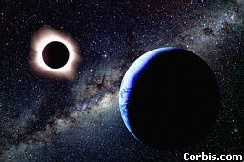
DNA by the Numbers
Each cell has about 2 m of DNA.
The average human has 75 trillion cells.
The average human has enough DNA to go from the earth to the sun more than 400 times.
DNA has a diameter of only 0.000000002 m.
The earth is 150 billion m
or 93 million miles from
the sun.
Notes:
If you unravel all the DNA in the chromosomes of one of your cells, it would stretch out 2 meters. If you did this to the DNA in all your cells, it would stretch from here to sun more than 400 hundred times!

Slide 3
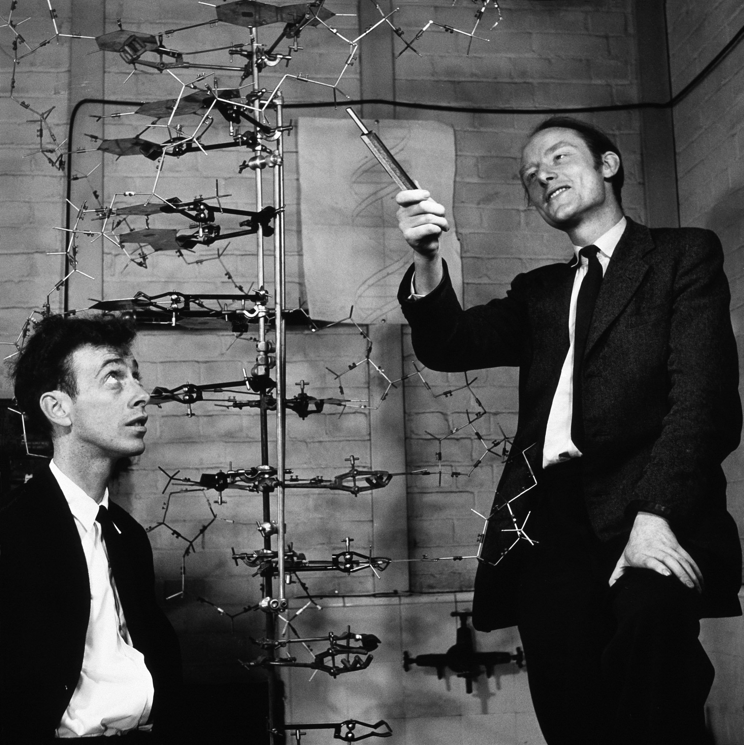
Watson & Crick – the original DNA M0del

Slide 4
The Double Helix Molecule
The DNA double helix has two strands twisted together.
Notes:
We will take apart the DNA molecule to see how it is put together.
First, we will look at one strand.

Slide 5
One Strand of DNA
The backbone of the molecule is alternating phosphates and deoxyribose sugar
The teeth are nitrogenous bases.
phosphate
deoxyribose
bases
Notes:
{Point to the 3-D mode, if you have one, to show the parts as you discuss them.}

Slide 7
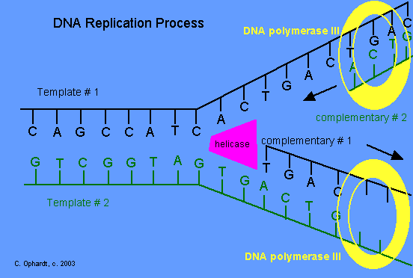
Replicate the strand of DNA shown below.
A – C – T – A – C – G – G – G – A – C – T – T
T – G – A – T – G – C – C – C – T – G – A – A
Notes:
Have students replicate the strand of DNA on their paper.
When displaying the DNA replication Process diagram, indicate how the initial strand unwinds and separated to create 2 strands identical to the initial strand.

Slide 8
Transcribe the strand of DNA shown below.
A – C – T – A – C – G – G – G – A – C – T – T
U – G – A – U– G – C – C – C – U – G – A – A
What is the strand formed called?
Messenger RNA
Notes:
Have students use transcription to create a single stranded RNA. Indicate where a Uracil is now paired with an adenine instead of a thymine.
Display the question and have students answer.

Slide 9
Determine the protein (peptide chain) for which the DNA codes.
A – C – T – A – C – G – G – G – A – C – T – T
U – G – A – U– G – C – C – C – U – G – A – A
FIRST: Use transcription to form mRNA.
NEXT: Find the correct codon sequence.
met
pro
STOP
Lastly: Use the codon chart to find the corresponding amino acids.
Notes:
Display the first textbox, have students complete.
Next display the second textbox.
When displaying the codon lines, ask students WHY did I start at AUG and not UGA? AUG is the START CODON.

Slide 10
Determine how the following DNA mutation will effect the protein strand.
A – C – T – A – C – G – G – G – A – C – T – T
insertion
A – C - C – T – A – C – G – G – G – A – C – T – T
U – G – G – A - U– G – C – C – C – U – G – A – A
met
pro
STOP
Notes:
Ask students why the protein strand did change even though there was a mutation? (The mutation occurred in a non-coding area) Ask students, “What would happen if there is a mutation in the STOP codon? (The amino acids will continue to add to the chain until another STOP codon occurred.)

Slide 11
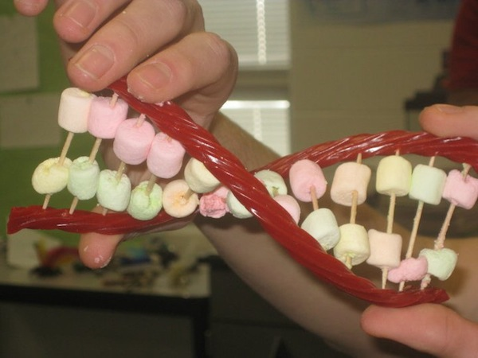
Have Your DNA & Eat It Too!
You should have the following:
-10 toothpicks
-2 twizzlers
-9 of each color marshmallow
Step 1 – Choose one of the sequences below
Sequence 1: T A C G T A T G A A
Sequence 2: T G G T T T A G A A
Step 2 – Create a key.
Adenine (A) = GREEN
Thymine (T) = PINK
Cytosine (C) = YELLOW
Guanine (G) = ORANGE
Step 3 – Replicate your DNA molecule. Record.
Step 4 – Carefully twist your DNA & take a picture.
Step 5 – EAT IT! ☺

