Slide 1
Microscope Questions
Now that you have EXPLORED the different types of microscopes, it is now time for the opportunity to demonstrate and explain what you have learned.
Each slide contains a question or image about a type of microscope(s). You and a partner are to chose the correct microscope or microscopes that answer the question and justify your answer.
You may use the completed Types of Microscopes Attribute grid as a resource if you like.
Complete in Notebook.

Slide 2
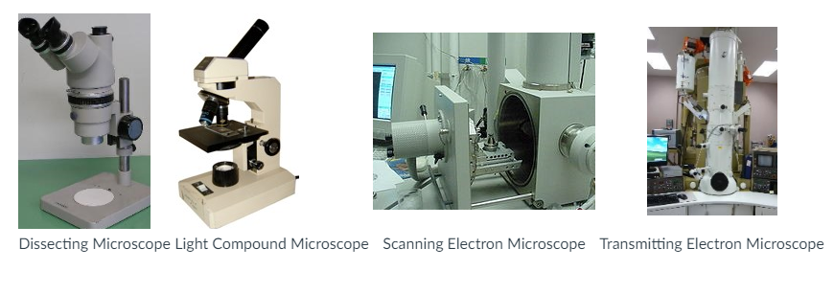
Obtain pictures from teacher. Glue into notebook.

Slide 3
1

Slide 4
2

Slide 5
3

Slide 6
4

Slide 7
5

Slide 8
6

Slide 9
7

Slide 10
8

Slide 11
9

Slide 12
10

Slide 13
11

Slide 14
12

Slide 15
13

Slide 16
14

