Slide 1
Microscope quiz Review
Biology I Honors

Slide 2
Which statement BEST describes a similarity between phase contrast microscopes and scanning electron microscopes?
A. Both use electrons to produce images of microscopic organisms.
B. Light is used to produce images up to 1000X magnification.
C. External structures can be viewed.
D. Electrons are used to bend light around an object in order to produce an image.

Slide 3
Which part of a light compound microscope is used to make an image sharper?
A. Objective
B. Stage
C. Eyepiece
B. Fine focus

Slide 4
Which part should be used to carry a microscope?
A. Eyepiece
E. A and D
B. Arm
F. B and D
C. Stage
G. C and D
D. Base

Slide 5
Which statement BEST describes SEMs and TEMs?
A. SEMs use electrons to scan the surface of an organism, while in contrast, TEMs transmit electrons through an organism.
Both, SEMs and TEMs, use intense streams of light, that are sent, through a vacuum, to produce an image on a computer screen.
C. SEMs allow microbiologists to view all internal structures of organisms; whereas, a TEM only transmits images of larger organelles, such as the nucleus and mitochondria.
The SEM, being the most powerful microscope, is only used to view very tiny objects, while the TEM is used to view details of any sized object.

Slide 6
Which objective would be used to initially find an object under a microscope?
A. 4x
B. 10x
C. 40x
D. 100x

Slide 7
Calculating magnification
Take the magnification of the objective and multiply by 10, which is the magnification of the eyepiece.
EX: 40 x 10 = 400 magnification or 400x
What would be the total magnification if an amoeba was viewed with the 10x objective of a light compound microscope?
100x

Slide 8
Write the Answer
What are the 4 types of microscopes we learned about?
Which type of microscope uses refraction of light?
Which microscopes used electrons in a vacuum?
Which microscope has a magnification up to 1000X?
What is the magnification of a TEM?
Which microscope produces 3 dimensional images?
Light compound
Phase contrast
scanning electron
Transmission electron
Phase contrast
1,000,000x
light compound and phase contrast
SEM
SEM and TEM

Slide 9
Which made this image?
TEM

Slide 10
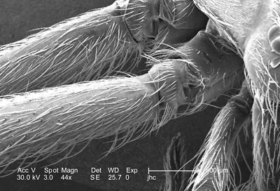
Which made this image?
SEM

Slide 11
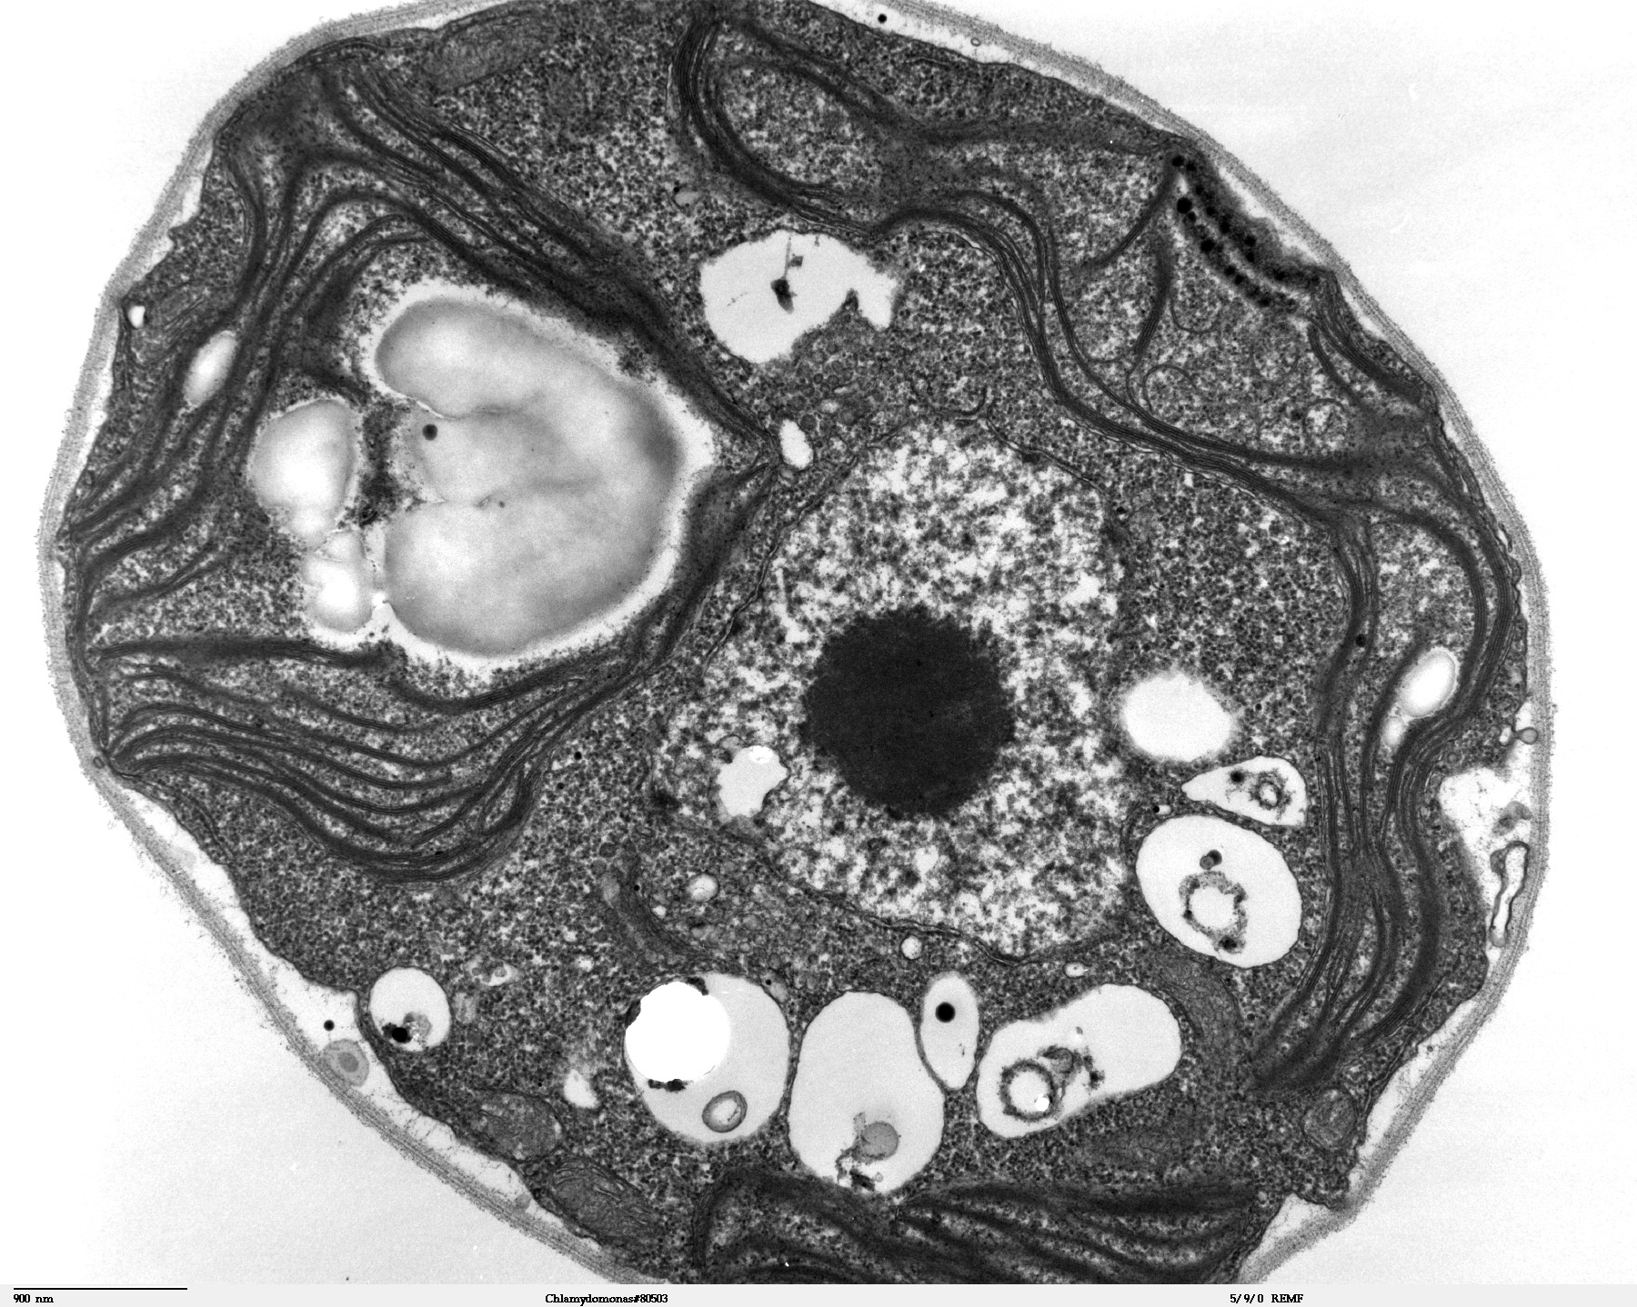
Which made this image?
TEM

Slide 12
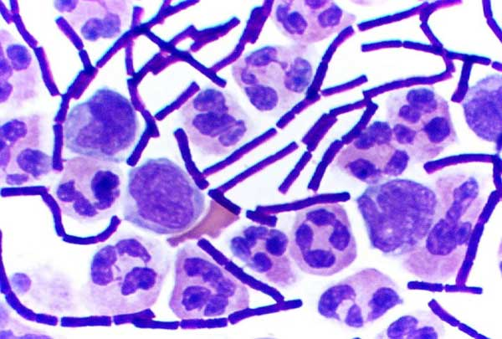
Which made this image?
Light compound
microscope

Slide 13
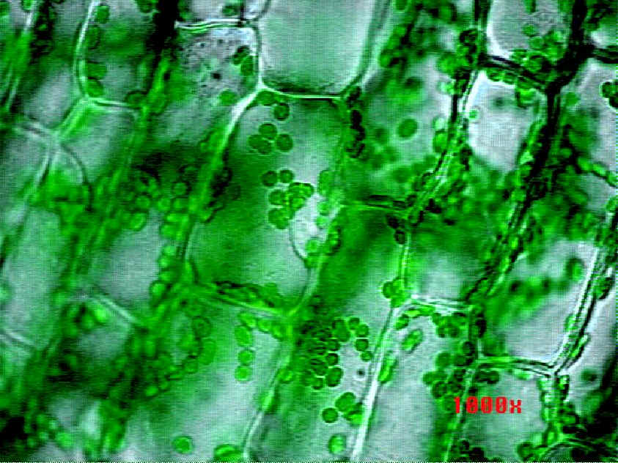
Which made this image?
Light compound
microscope

Slide 14
How ready are you for the quiz/test?
1. I am not ready at all and have to study tonight.
2. I know some of the information, but would not do well with the knowledge I have now.
3. I answered most questions correctly and with a little more study time, should do well on the quiz/test.
4. I would ROCK this quiz/test if I took it right now!

