Slide 1
Microscope quiz Review
Mrs. Barnes
Biology I Honors

Slide 2
Which statement BEST describes a similarity between phase contrast microscopes and scanning electron microscopes?
A. Both use electrons to produce images of microscopic organisms.
B. Light is used to produce images up to 1000X magnification.
C. External structures can be viewed.
D. Electrons are used to bend light around an object in order to produce an image.

Slide 3
Which part of a light compound microscope is used as a surface for a slide?
A. Objective
B. Stage
C. Eyepiece
B. Fine focus

Slide 4
Which part should be used to carry a microscope?
A. Eyepiece
E. A and D
B. Arm
F. B and D
C. Stage
G. C and D
D. Base

Slide 5
Which statement BEST describes SEMs and TEMs?
A. SEMs use electrons to scan the surface of an organism, while in contrast, TEMs transmit electrons through an organism.
Both, SEMs and TEMs, use intense streams of light, that are sent, through a vacuum, to produce an image on a computer screen.
C. SEMs allow microbiologists to view all internal structures of organisms; whereas, a TEM only transmits images of larger organelles, such as the nucleus and mitochondria.
The SEM, being the most powerful microscope, is only used to view very tiny objects, while the TEM is used to view details of any sized object.

Slide 6
Which part of a compound microscope provides light needed to see an object?
A. objective
B. illuminator
C. Fine adjustment
D. Eye piece

Slide 7
Calculating magnification
Take the magnification of the objective and multiply by 10, which is the magnification of the eyepiece.
EX: 40 x 10 = 400 magnification or 400x
What would be the total magnification if an amoeba was viewed with the 10x objective of a light compound microscope?
100x

Slide 8
Write the Answer
Which microscope produces 3 dimensional images?
What are the 5 types of microscopes we learned about?
What is the magnification of a TEM?
Which microscope has a magnification up to 1000X?
Which microscope is used to view larger objects or organisms?
Which microscopes used electrons in a vacuum?
Which type of microscope uses refraction of light?
Light compound
Phase contrast
scanning electron
Transmission electron
Dissecting
SEM and Dissecting
light compound and phase contrast
Phase contrast
Dissecting
SEM and TEM
1,000,000x

Slide 9
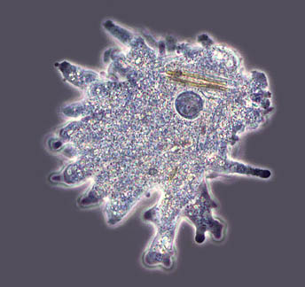
Which made this image?
Phase contrast

Slide 10
Which made this image?
TEM

Slide 11
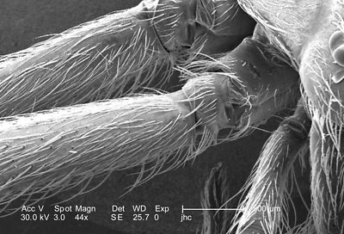
Which made this image?
SEM

Slide 12
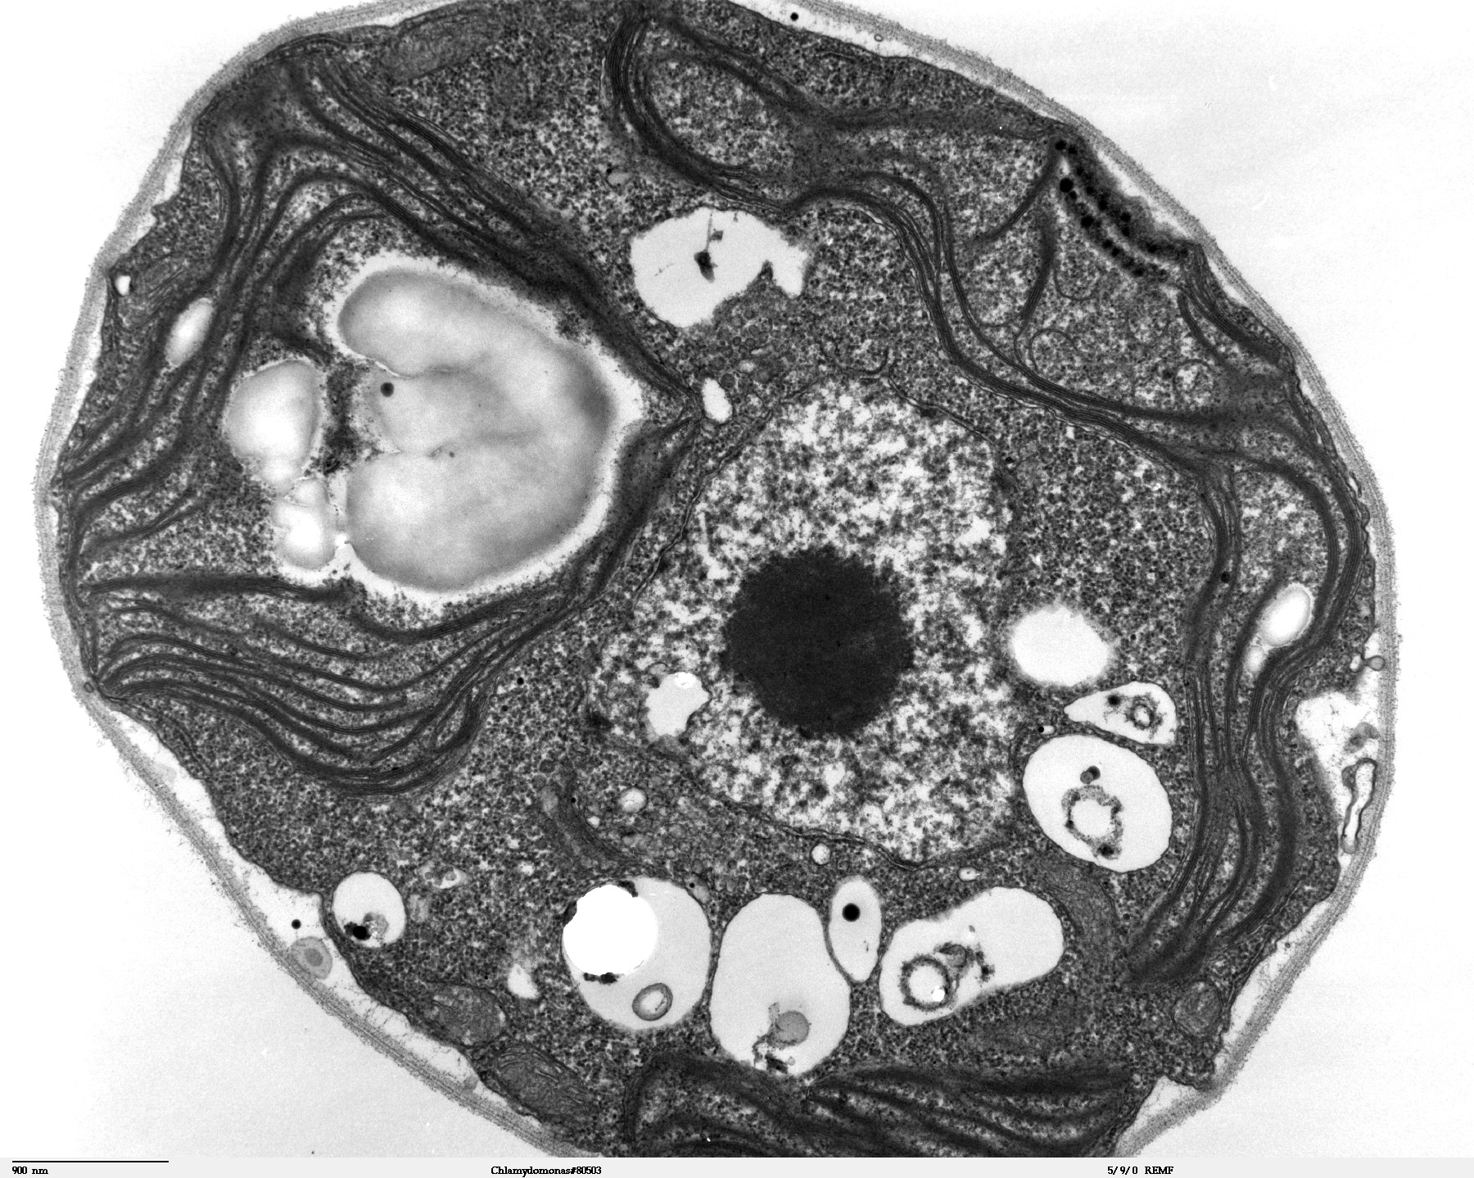
Which made this image?
TEM

Slide 13
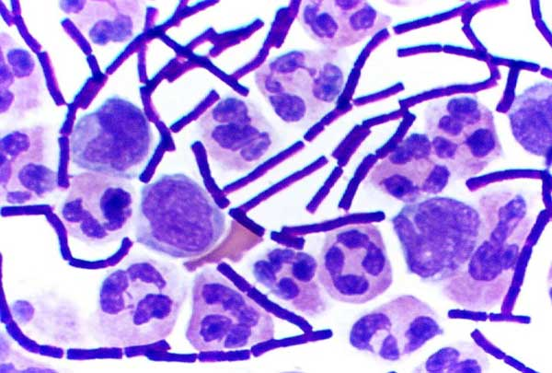
Which made this image?
Light compound
microscope

Slide 14
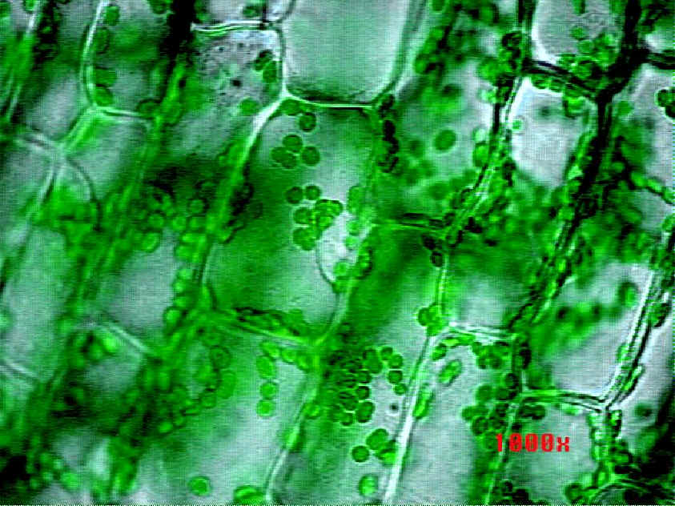
Which made this image?
Light compound
microscope

Slide 15
How ready are you for the quiz/test?
1. I am not ready at all and have to study tonight.
2. I know some of the information, but would not do well with the knowledge I have now.
3. I answered most questions correctly and with a little more study time, should do well on the quiz/test.
4. I would ROCK this quiz/test if I took it right now!

