Slide 1
Mitosis, Cell Cycle, Meiosis
Test Review
Biology I Honors

Slide 2
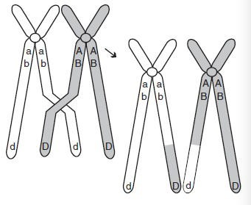
The diagram below shows homologous chromosomes during prophase I of meiosis.
Which of the following correctly describes the process being illustrated?
A. mutation in which the DNA content of the gene is altered
B. segregation of sister chromatids
C. condensation and segregation of alleles
D. crossing-over in which alleles are exchanged

Slide 3
Identify the part indicated
Centromere
Sister chromatids
chromosome

Slide 4
Is the cell haploid or diploid?
Parent cell of mitosis
Diploid
Parent cell of meiosis
Diploid
Daughter cells of meiosis
Haploid
Daughter cells of mitosis
Diploid

Slide 5
How many are there?
Parent cells in mitosis
1
Parent cells meiosis
1
Daughter cells in meiosis
4
Daughter cells in mitosis
2

Slide 6
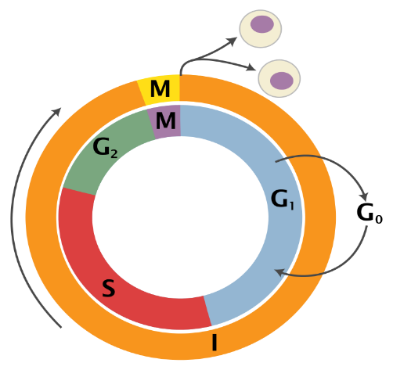
During which stage of the cell cycle does DNA replicate?
Synthesis

Slide 7
During which stage of the cell cycle does Cell Division occur?
M-phase

Slide 8
During which stage of the cell cycle does the cell prepare for mitosis?
Gap 2

Slide 9
List the stages of the cell cycle in the order they occur.
Gap 1,
synthesis,
Gap 2,
Mitosis

Slide 10
List the stages below in the order they occur.
Interphase
Cytokinesis
Anaphase
Telophase
Prophase
Metaphase
Interphase
Prophase
Metaphase
Anaphase
Telophase
Cytokinesis

Slide 11
What type of cells are formed during meiosis?
Sex Cells/Gametes

Slide 12
How many autosomes are there in a human cell?
44 autosomes
22 pairs

Slide 13
If a frog has 26 chromosomes, how many chromosomes will be in it’s gametes?
13
n = haploid

Slide 14
If a cat gamete has 38 chromosomes, how many will it’s somatic cells have?
38
2n = diploid

Slide 15
Which of the following is a substance that causes cancer?
A. Autosome
B. Malignant
C. Carcinogen
D. benign

Slide 16
Match’em up!
1. 2n number of chromosomes
2. Chromosome pair
3. X and Y chromosomes
4. n number of chromosomes
5. Joining of gametes
6. Body cells
7. Chromosome pairs 1-22
8. Sperm and ova
somatic cell
B. Gametes
C. Homologous chromosome
D. Autosome
E. sex chromosome
F. diploid
G. Haploid
H. fertilization

Slide 17
Match’em up!
somatic cell 6. Body cells
B. Gametes 8. sperm and ova
C. Homologous chromosome 2. chromosome pair
D. Autosome 7. chromosomes 1-22
E. sex chromosome 3. X and Y
F. Diploid 1. 2n
G. Haploid 4. n
H. Fertilization 5. joining of gametes

Slide 18
Which statement about mitosis is true?
A. All cells involved in mitosis are diploid.
B. The daughter cells produced during mitosis are genetically different.
C. Two parent cells are needed for mitosis.
D. Mitosis involves 2 cell divisions.

Slide 19
Which of the following BEST describes metaphase I?
A. Homologous chromosomes are identical.
B. Chromosomes line up with sister chromatids on either side of the middle plane of a cell.
C. Homologous chromosomes line up on separate sides of the cell’s equator.
D. Crossing over occurs during this phase.

Slide 20
During which stage of meiosis do the homologous pairs separate?
A. Metaphase I
B. Telophase II
C. Prophase II
D. Anaphase I

Slide 21
What is the difference between a benign tumor and a malignant tumor?
A benign tumor is located on the inside of an organ and a malignant tumor is located on the outside of an organ.
Benign tumors contain abnormal cells that stay in a capsule, whereas, malignant tumors have abnormal cells that have spread throughout the body.
The cells in a benign tumor are normal, but there are more of them. Whereas, a malignant tumor contains abnormal cells.
Benign tumors are ones in which the cells have broken off while the malignant tumor remains contained.

Slide 22
What is a tumor?
A. A large cancer cell.
B. A contained mass of cancer cells.
C. Cancer cells that have entered the circulatory system.
D. Non-lethal cancer cells.

Slide 23
Which type of cell division is used to replace body cells.
mitosis

Slide 24
What are the 3 ways the cell cycle can be regulated?
Cell to cell contact
Chemicals
apoptysis

Slide 25
Which statement is true in regards to meiosis?
A. The cells formed after meiosis I and meiosis II are haploid.
B. The two parent cells in meiosis I divide twice to form 4 daughter cells.
C. The cells produced at the end of meiosis II are haploid.
D. A parent cell proceeds through one cell division to form a daughter cell.

Slide 26
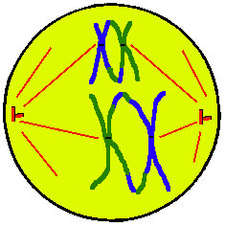
Metaphase I

Slide 27
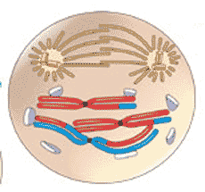
Prophase II

Slide 28
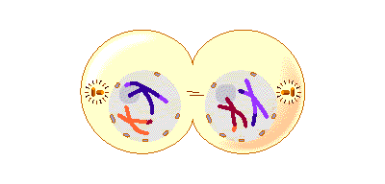
Telophase I

Slide 29
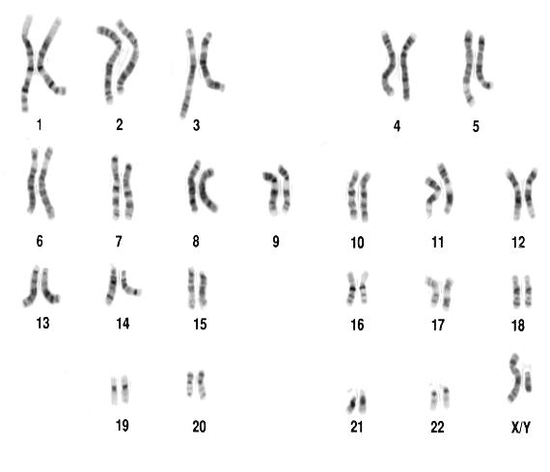
What is this?
Karyotype

Slide 30
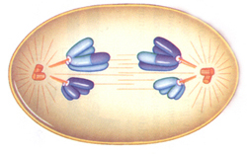
Anaphase I

Slide 31
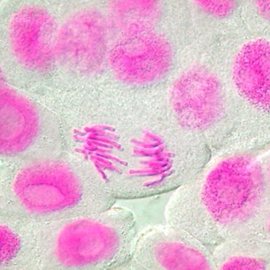
Anaphase of mitosis

Slide 32
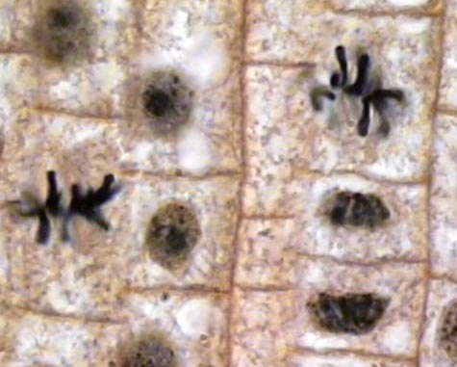
Metaphase of Mitosis

Slide 33
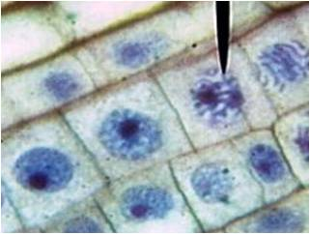
Prophase of mitosis

Slide 34
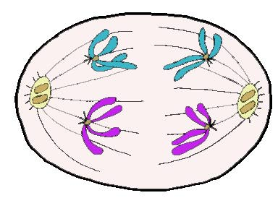
Identify the phase
Anaphase I

Slide 35
Identify the phase
Anaphase II

Slide 36
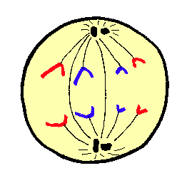
Identify the phase
Anaphase of mitosis

Slide 37
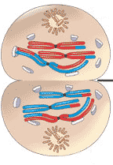
Identify the phase
Telophase I of mitosis

Slide 38
Identify the phase
Prophase

Slide 39
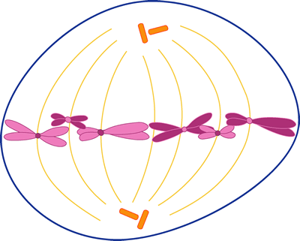
Identify the phase
Metaphase
mitosis

