Slide 1
Environmental Science Fair PowerPoint Template & Instructions
– delete this slide
DUE DATES:
First Draft version of your completed powerpoint content reneetoybarnett@gmail.com Thursday, Dec. 16th, 2019
“adequate progress” check only
FINAL Draft version of your completed powerpoint slides reneetoybarnett@gmail.com
NO LATER THAN Monday, Jan. 20th, 2020
This is part of your presentation!
Ms. Barnett will open gmail and use your FINAL DRAFT powerpoint slides for you to use as you to present your Science Fair project to the class.

Slide 2
PowerPoint Template – delete this slide
Fill in the appropriate slides.
Remove any bold or italicized words after you’ve added your changes.
Delete slides that say, “delete this slide” when you are done.

Slide 3
PowerPoint - delete this slide
Minimum font size is 20 point.
After you’ve filled out the template, then you may add themes, colors and animations (not required).
Remember, animations should not deter from the flow of the presentation!

Slide 4
Science Fair Power Point
Check List – delete this slide
Title Page
Project Overview
Background Research
Works Cited / Bibliography
Key Science Words
Variables
Hypothesis
Materials
Procedures
Safety Precautions
Photographs or Graphics
Data Table
Graph
Observations
Analysis/Discussion
Possible Sources of Error
Conclusion
Reflection
Future Research

Slide 5
(You are answering this question by doing something, how can you reduce or stop the problem) Questions to Consider:
https://populationeducation.org/environmental-science-fair-projects-30-eco-friendly-ideas/
https://www.sciencebuddies.org/science-fair-projects/project-ideas/environmental-science

Slide 6
Additional Resources (here are a few ideas)
https://www.juliantrubin.com/fairprojects/botany/algae.html
http://news.ufl.edu/articles/2018/08/what-is-causing-floridas-algae-crisis-5-questions-answered.php
https://www.education.com/science-fair/article/eutrophication/

Slide 7
Science Fair Title: The Effect of (IV) on (DV) What are you going to investigate? (delete this)
Name
Period
Teacher
Grade

Slide 8
Project Overview
Write 4-8 well developed sentences which provide a brief overview/summary of your project.
State and explain the purpose.
What are you trying to find out?
Why did you choose this topic?
State the real life applications.
What was your original problem/question?
(Hint: Use “Science Fair Information Packet!)

Slide 9
Background Research
1 paragraph for each resource = 1 bullet point
Each bullet pointed paragraph will include sentences that not only summarize your research, but also explain your ideas/questions & help your class understand what is occurring in your experiment. It should start with an attention grabber to get the reader interested in your experiment. It should be very clear how your research relates to your science fair project!
1st bullet point
2nd bullet point
3rd bullet point
(add additional resources as needed!)

Slide 10
Background Research
1st bullet point

Slide 11
Background Research Continued
2nd bullet point

Slide 12
Background Research Continued
3rd bullet point

Slide 13
Background Research Continued
Delete this slide if you don’t require more room!!

Slide 14
Works Cited / Bibliography
Be sure to include print and electronic
sources and put them in alphabetical order.
You must also cite any graphics or photos used.

Slide 15
Key Science Words
List and define 3-5 key higher level vocabulary words/concepts which DIRECTLY relate to your project and/or research.
Example:
Salinity – the measure of all the dissolved salts in water. Usually measured in parts per thousand (ppt). The average ocean salinity is 35ppt.

Slide 16
Variables
The independent variable for the experiment was (list IV).
The 3 (or more) levels of the independent variable were:
-
-
-
The dependent variable for the experiment was (list DV) and was measured in/by (list metric units or scale used).

Slide 17
Variables:
Constants throughout the experiment were: (list at least 4 constants):
-
-
-
-
(If applicable)
The control group for the experiment was (list control or describe the setup of the control).

Slide 18
Hypothesis
If (IV: level, level, level), then (THIS level) will (change how? DV), because (scientifically based, researched reason).
Written in an IF, THEN, BECAUSE format.
Must include all IV levels.
Must offer researched support for your tentative explanation.
Do not use personal pronouns.

Slide 19
Running the Experiment
For the remaining slides you are using data from research and experiments that other scientists have completed.
We will also conduct an algae lab in class that you will use in your data.

Slide 20
Materials
Type a detailed list of the items you needed to complete your experiments. (use numbers or bullets)
This should include a detailed list of all the equipment and materials you need. You must be specific enough so that someone could exactly duplicate your experiment.
You may include pictures of your materials set out together.
Use brand names and/or numbers when needed.
Be specific about the amounts used.
ALL MEASUREMENTS must be METRIC (SI).
Example:
Item #1: Beaker: plastic, 600 mL, Nalgene®
Item #2: etc.
Item #3: etc.
Do not use personal pronouns.

Slide 21
Procedures
List all of the steps used in completing your experiment.
Your procedures list must have at least 10 distinct steps.
The procedure must be detailed enough that another experimenter could exactly duplicate your experiment.
Remember to number your steps. Your procedure should include the correct sequence of all necessary.
ALL MEASUREMENTS must be METRIC (SI).
Example:
1) Gather together all the materials needed for the experiment.
2) etc.
3) etc.
4) Repeat steps 2a – 2d for each level.
5) etc.

Slide 22
Procedures continued
Delete this slide if it is not needed
Copy this slide if there are more procedures

Slide 23
Safety Precautions
You must list all necessary Safety Precautions. (minimum of 2)
First give a short description of the rule and then give a reason why each rule applies to your experiment.
Safeguarding your experiment could be one of your precautions.
Example: 1. No Horseplay because goofing around might break something or hurt the experiment, meaning I would have to start all over again.

Slide 24
Photographs/Graphics (minimum of 1 photo is required)
You may include NO MORE than two slides of photographs, drawings or graphics which directly relate to your project.
These photos may be placed on other slides,
but the combined total should not exceed three full slides.
Possible photos could include photos: taken during your experiment, showing your materials set out, action shots, screen capture of video clips, visual comparison between levels and control group, etc.
Provide titles and captions.
You must cite the use of all graphics, drawings, photos taken from other sources in your bibliography.
** NO FACES MAY BE SHOWN IN ANY PHOTOS **

Slide 25
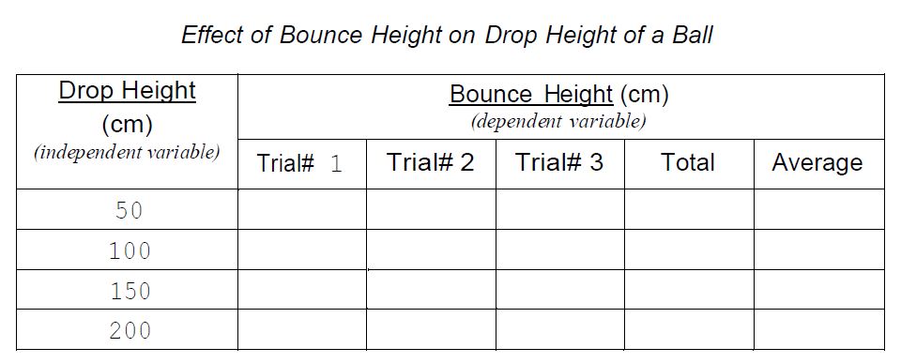
Data Table
Use Microsoft Excel, etc. to create a data table and import it here.
Make sure to include proper title, labels and units, use the format shown below!
If you have multiple tables use multiple slides.
Example Data Table Format
Experimental Title
“Effect of IV on DV” (capitalize as you would any title)
DV
(units in metric if applicable)
IV
(units in metric if applicable)
IV LEVLES
(include control if applicable)

Slide 26
Data Table Continued
Delete slide if it is not needed
Copy this slide if you have more data tables

Slide 27
Graph
Now it is time to review your data and observations to find out what happened. Think about the best way to show your data: bar graph, line graph, etc. and then create using your data.
Create a graph and import it here.
Make sure to include proper title, labels and units.
This may be created using a computer program and imported.
OR
This may be created on graph paper and a clear photo may be imported.
If you select this option you MUST print and paste all labels, titles, etc. onto your graph using 18 pt font as required on all slides. No words may be handwritten.

Slide 28
Observations
Type a brief summary paragraph, 5-10 well developed sentences, of what you observed using your five senses (qualitative) during your experiment as you collected data (quantitative).

Slide 29
Discussion of Results
Write 1-2 PARAGRAPHS explaining the results of your
experiment and what the results mean.
Questions to Consider when writing your results:
What did you observe during your experiment?
What happened?
What do you notice about your data? Are there any numbers that stick out or form a pattern?
Describe in COMPLETE sentences what the numbers tell you.
Are there any numbers that seem out of place?
What are those numbers and why do you think they are out of place? Explain!

Slide 30
Discussion of Results continued

Slide 31
Possible Sources of Error
Although the experiment was controlled, there were still some possible sources of error.
The errors identified are:
-
-
-
For the future, (state what may be changed to reduce or remove these errors)

Slide 32
Conclusion
After you have determined your results, it is time to decide the answer to your original question. Write a brief summary of what you discovered based on your data using the format below.
The hypothesis was (supported or refuted).
(If supported) This happened because (give explanation).
(If refuted) This occurred because (give scientific reasons why if was refuted or wrong).

Slide 33
Reflection
Your reflection is a paragraph that gives other ideas that may take your project in a different direction.
If you improved your experiment what would you do differently?
In what ways might you advance, improve, or expand on this project?
You may also include any questions that you may still have about this project.

Slide 34
Future Research
Future studies could focus on (future research question the effect of IV on DV).
This could be tested by repeating the same experiment, except (briefly explain how it would be different).
This would be useful to determine _____ because ______. (remove underlines and complete with your responses)

Slide 35
Future Research
Another problem that could be investigated is (future research question the effect of IV on DV).
This could be answered by (briefly explain)
The implications of this research would be of interest to _____ (remove underlines and complete with your responses).

